Slide 1
Programming in Java
Java basics
Elementary programming, selections, characters and strings, loops, methods, arrays, recursion
Object-Oriented Programming · Alba Meca

Slide 2
Trace a Program Execution
public class ComputeArea {
/** Main method */
public static void main(String[] args) {
double radius;
double area;
// Assign a radius
radius = 20;
// Compute area
area = radius * radius * 3.14159;
// Display results
System.out.println("The area for the circle of radius " +
radius + " is " + area);
}
}
memory
radius
no value
allocate memory for radius
OOP · Java basics · 2

Slide 3
Trace a Program Execution
public class ComputeArea {
/** Main method */
public static void main(String[] args) {
double radius;
double area;
// Assign a radius
radius = 20;
// Compute area
area = radius * radius * 3.14159;
// Display results
System.out.println("The area for the circle of radius " +
radius + " is " + area);
}
}
memory
radius
no value
area
no value
allocate memory for area
OOP · Java basics · 3

Slide 4
Trace a Program Execution
public class ComputeArea {
/** Main method */
public static void main(String[] args) {
double radius;
double area;
// Assign a radius
radius = 20;
// Compute area
area = radius * radius * 3.14159;
// Display results
System.out.println("The area for the circle of radius " +
radius + " is " + area);
}
}
memory
radius
20
area
no value
assign 20 to radius
OOP · Java basics · 4

Slide 5
Trace a Program Execution
public class ComputeArea {
/** Main method */
public static void main(String[] args) {
double radius;
double area;
// Assign a radius
radius = 20;
// Compute area
area = radius * radius * 3.14159;
// Display results
System.out.println("The area for the circle of radius " +
radius + " is " + area);
}
}
memory
radius
20
area
1256.636
compute area and assign it
to variable area
OOP · Java basics · 5

Slide 6

Trace a Program Execution
public class ComputeArea {
/** Main method */
public static void main(String[] args) {
double radius;
double area;
// Assign a radius
radius = 20;
// Compute area
area = radius * radius * 3.14159;
// Display results
System.out.println("The area for the circle of radius " +
radius + " is " + area);
}
}
memory
radius
20
area
1256.636
print a message to the console
OOP · Java basics · 6

Slide 7
Reading Input from the Console
1. Create a Scanner object
import java.util.Scanner; // at the top of the file
Scanner input = new Scanner(System.in);
2. Use the methods next(), nextByte(), nextShort(), nextInt(), nextLong(), nextFloat(), nextDouble(), or nextBoolean() to obtain a string, byte, short, int, long, float, double, or boolean value. For example,
System.out.print("Enter a double value: ");
Scanner input = new Scanner(System.in);
double d = input.nextDouble();
▶ ComputeAreaWithConsoleInput
▶ ComputeAverage
OOP · Java basics · 7

Slide 8
Identifiers
▫ An identifier is a sequence of characters that consist of letters, digits, underscores (_), and dollar signs ($).
▫ An identifier must start with a letter, an underscore (_), or a dollar sign ($). It cannot start with a digit.
– An identifier cannot be a reserved word.
▫ An identifier cannot be true, false, or null.
▫ An identifier can be of any length.
OOP · Java basics · 8

Slide 9
Variables
// Compute the first area
radius = 1.0;
area = radius * radius * 3.14159;
System.out.println("The area is " + area + " for radius "+radius);
// Compute the second area
radius = 2.0;
area = radius * radius * 3.14159;
System.out.println("The area is " + area + " for radius "+radius);
OOP · Java basics · 9

Slide 10
Declaring Variables and Assignment Statements
Declaring variables
int x; // Declare x to be an
// integer variable;
double radius; // Declare radius to
// be a double variable;
char a; // Declare a to be a
// character variable;
Assignment statements
x = 1; // Assign 1 to x;
radius = 1.0; // Assign 1.0 to radius;
a = 'A'; // Assign 'A' to a;
Declaring and initializing in one step
int x = 1;
double d = 1.4;
OOP · Java basics · 10

Slide 11
Constants
final datatype CONSTANTNAME = VALUE;
final double PI = 3.14159;
final int SIZE = 3;
OOP · Java basics · 11

Slide 12
Numerical Data Types
Name | Range | Storage Size
byte | -2⁷ (-128) to 2⁷–1 (127) | 8-bit signed
short | -2¹⁵ (-32768) to 2¹⁵–1 (32767) | 16-bit signed
int | -2³¹ (-2147483648) to 2³¹–1 (2147483647) | 32-bit signed
long | -2⁶³ to 2⁶³–1 (i.e., -9223372036854775808 to 9223372036854775807) | 64-bit signed
float | Negative range: -3.4028235E+38 to -1.4E-45 Positive range: 1.4E-45 to 3.4028235E+38 | 32-bit IEEE 754
double | Negative range: -1.7976931348623157E+308 to -4.9E-324 Positive range: 4.9E-324 to 1.7976931348623157E+308 | 64-bit IEEE 754
OOP · Java basics · 12

Slide 13
Numeric Operators
Name | Meaning | Example | Result
+ | Addition | 34 + 1 | 35
- | Subtraction | 34.0 - 0.1 | 33.9
* | Multiplication | 300 * 30 | 9000
/ | Division | 1.0 / 2.0 | 0.5
% | Remainder | 20 % 3 | 2
OOP · Java basics · 13

Slide 14
Integer Division
+, -, *, /, and %
5 / 2 yields an integer 2.
5.0 / 2 yields a double value 2.5
5 % 2 yields 1 (the remainder of the division)
OOP · Java basics · 14

Slide 15
NOTE
Calculations involving floating-point numbers are approximated because these numbers are not stored with complete accuracy. For example,
System.out.println(1.0 - 0.1 - 0.1 - 0.1 - 0.1 - 0.1);
displays 0.5000000000000001, not 0.5, and
System.out.println(1.0 - 0.9);
displays 0.09999999999999998, not 0.1. Integers are stored precisely.
Therefore, calculations with integers yield a precise integer result.
OOP · Java basics · 15

Slide 16
Number Literals
A literal is a constant value that appears directly in the program.
For example, 34, 1,000,000, and 5.0 are literals in the following statements:
int i = 34;
long x = 1000000;
double d = 5.0;
OOP · Java basics · 16

Slide 17
Integer Literals
An integer literal can be assigned to an integer variable as long as it can fit into the variable. A compilation error would occur if the literal were too large for the variable to hold. For example, the statement byte b = 1000 would cause a compilation error, because 1000 cannot be stored in a variable of the byte type.
An integer literal is assumed to be of the int type, whose value is between -2³¹ (-2147483648) to 2³¹–1 (2147483647). To denote an integer literal of the long type, append it with the letter L or l. L is preferred because l (lowercase L) can easily be confused with 1 (the digit one).
OOP · Java basics · 17

Slide 18
Floating-Point Literals
Floating-point literals are written with a decimal point. By default, a floating-point literal is treated as a double type value. For example, 5.0 is considered a double value, not a float value. You can make a number a float by appending the letter f or F, and make a number a double by appending the letter d or D. For example, you can use 100.2f or 100.2F for a float number, and 100.2d or 100.2D for a double number.
Scientific Notation
Floating-point literals can also be specified in scientific notation, for example, 1.23456e+2, same as 1.23456e2, is equivalent to 123.456, and 1.23456e-2 is equivalent to 0.0123456. E (or e) represents an exponent and it can be either in lowercase or uppercase.
OOP · Java basics · 18

Slide 19
Numeric Type Conversion
When performing a binary operation involving two operands of different types, Java automatically converts the operand based on the following rules:
1. If one of the operands is double, the other is converted into double.
2. Otherwise, if one of the operands is float, the other is converted into float.
3. Otherwise, if one of the operands is long, the other is converted into long.
4. Otherwise, both operands are converted into int.
OOP · Java basics · 19

Slide 20
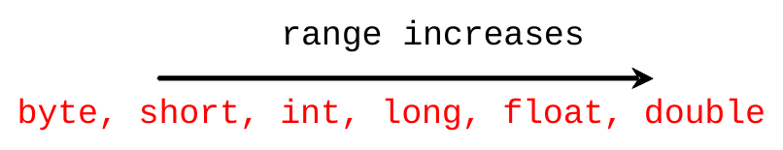
Type Casting
Implicit casting
double d = 3; (type widening)
Explicit casting
int i = (int)3.0; (type narrowing)
int i = (int)3.9; (Fraction part is truncated)
What is wrong? int x = 5 / 2.0;
OOP · Java basics · 20

Slide 21
Debugging
Logic errors are called bugs. The process of finding and correcting errors is called debugging. A common approach to debugging is to use a combination of methods to narrow down to the part of the program where the bug is located. You can hand-trace the program (i.e., catch errors by reading the program), or you can insert print statements in order to show the values of the variables or the execution flow of the program. This approach might work for a short, simple program. But for a large, complex program, the most effective approach for debugging is to use a debugger utility.
OOP · Java basics · 21

Slide 22
Debugger
Debugger is a program that facilitates debugging. You can use a debugger to
▫ Execute a single statement at a time.
▫ Trace into or stepping over a method.
▫ Set breakpoints.
▫ Display variables.
▫ Display call stack.
▫ Modify variables.
OOP · Java basics · 22

Slide 23
JOptionPane Input
Two ways of obtaining input.
1. Using the Scanner class (console input)
2. Using JOptionPane input dialogs
OOP · Java basics · 23

Slide 24
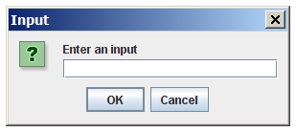
Getting Input from Input Dialog Boxes
import javax.swing.JOptionPane;
String input = JOptionPane.showInputDialog(
"Enter an input");
OOP · Java basics · 24

Slide 25
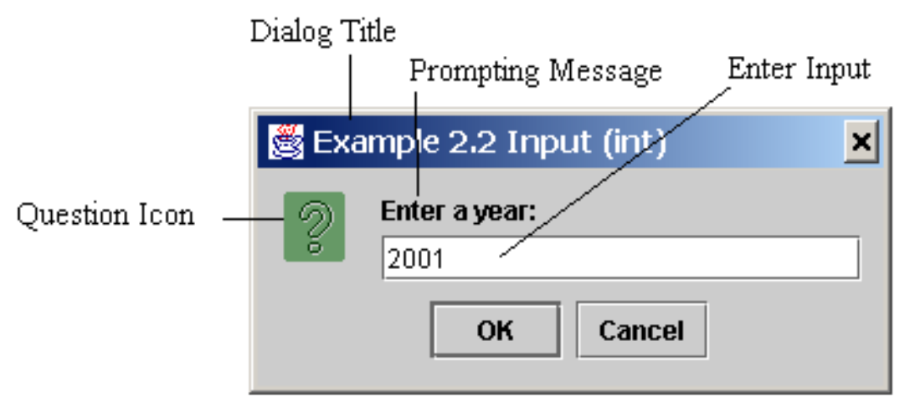
Getting Input from Input Dialog Boxes
String string = JOptionPane.showInputDialog(
null, "Prompting Message", "Dialog Title",
JOptionPane.QUESTION_MESSAGE);
OOP · Java basics · 25

Slide 26
Two Ways to Invoke the Method
There are several ways to use the showInputDialog method. For the time being, you only need to know two ways to invoke it.
One is to use a statement as shown in the example:
String string = JOptionPane.showInputDialog(null, x,
y, JOptionPane.QUESTION_MESSAGE);
where x is a string for the prompting message, and y is a string for the title of the input dialog box.
The other is to use a statement like this:
JOptionPane.showInputDialog(x);
where x is a string for the prompting message.
OOP · Java basics · 26

Slide 27
Converting Strings to Integers and Doubles
The input returned from the input dialog box is a string. If you enter a numeric value such as 123, it returns “123”. To obtain the input as a number, you have to convert a string into a number.
To convert a string into an int value, you can use the static parseInt method in the Integer class as follows:
int intValue = Integer.parseInt(intString);
where intString is a numeric string such as “123”.
To convert a string into a double value, you can use the static parseDouble method in the Double class as follows:
double doubleValue = Double.parseDouble(doubleString);
where doubleString is a numeric string such as “123.45”.
OOP · Java basics · 27

Slide 28
Selections
Java basics
OOP · Java basics · 28

Slide 29
The boolean Type and Operators
Often in a program you need to compare two values, such as whether i is greater than j. Java provides six comparison operators (also known as relational operators) that can be used to compare two values. The result of the comparison is a Boolean value: true or false.
boolean b = (1 > 2);
OOP · Java basics · 29

Slide 30
Comparison Operators
Operator | Name
< | less than
<= | less than or equal to
> | greater than
>= | greater than or equal to
== | equal to
!= | not equal to
OOP · Java basics · 30

Slide 31
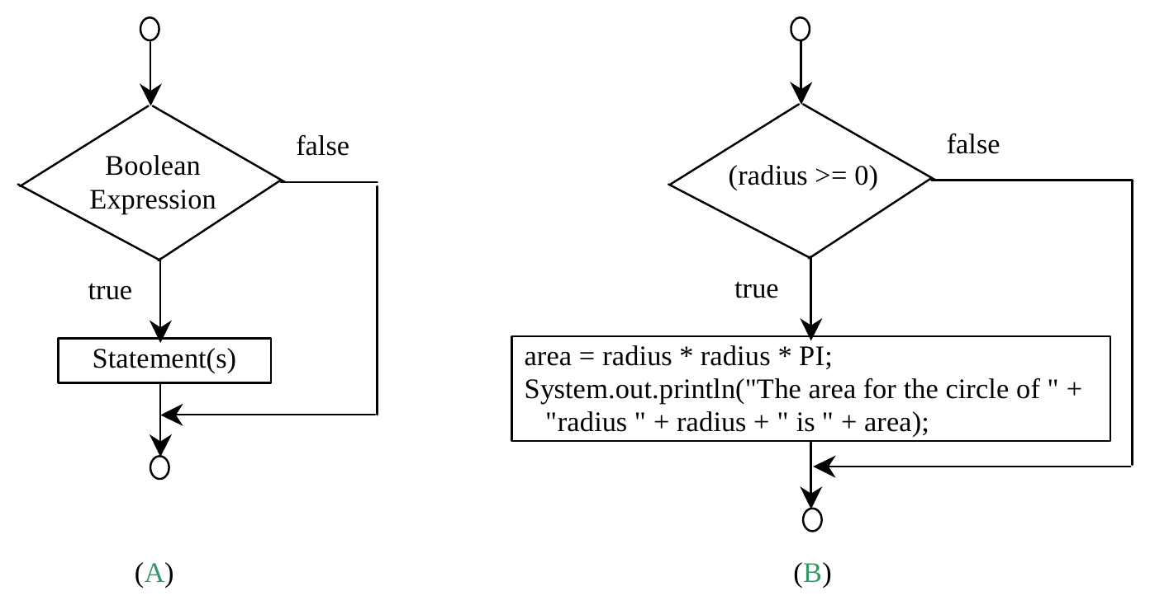
One-way if Statements
if (boolean-expression) {
statement(s);
}
if (radius >= 0) {
area = radius * radius * PI;
System.out.println("The area"
+ " for the circle of radius "
+ radius + " is " + area);
}
OOP · Java basics · 31

Slide 32
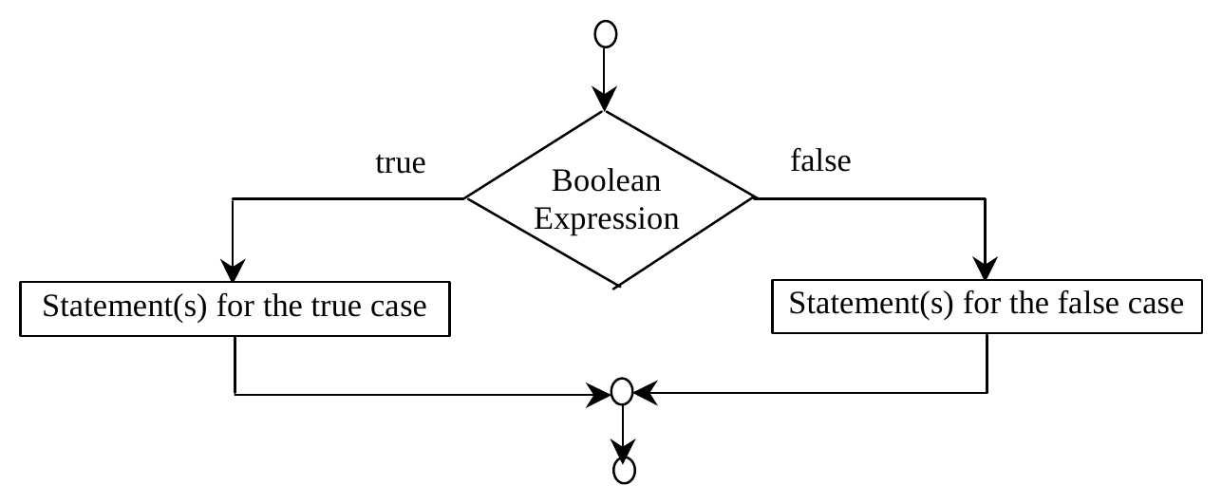
The Two-way if Statement
if (boolean-expression) {
statement(s)-for-the-true-case;
}
else {
statement(s)-for-the-false-case;
}
OOP · Java basics · 32

Slide 33
if...else Example
if (radius >= 0) {
area = radius * radius * 3.14159;
System.out.println("The area for the "
+ "circle of radius " + radius +
" is " + area);
}
else {
System.out.println("Negative input");
}
OOP · Java basics · 33

Slide 34
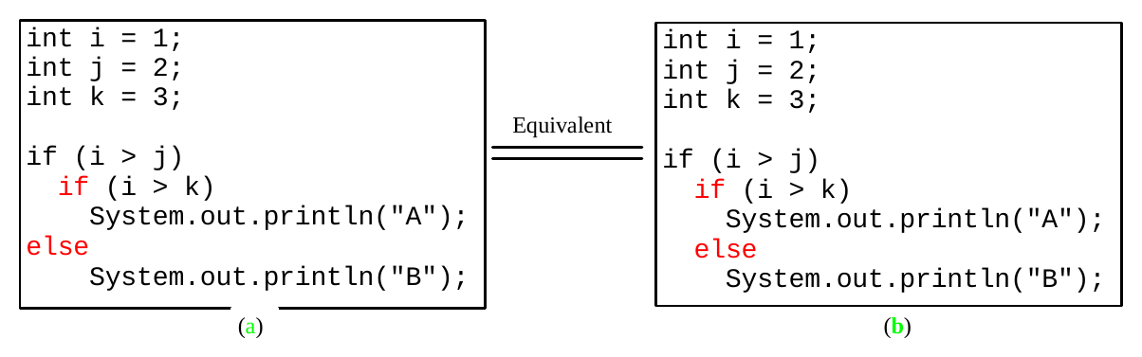
Note
▫ The else clause matches the most recent if clause in the same block.
OOP · Java basics · 34

Slide 35
Note, cont.
Nothing is printed from the preceding statement. To force the else clause to match the first if clause, you must add a pair of braces:
int i = 1;
int j = 2;
int k = 3;
if (i > j) {
if (i > k)
System.out.println("A");
}
else
System.out.println("B");
This statement prints B.
OOP · Java basics · 35

Slide 36
Common Errors
Adding a semicolon at the end of an if clause is a common mistake.
if (radius >= 0);
{
area = radius*radius*PI;
System.out.println(
"The area for the circle of radius " +
radius + " is " + area);
}
This mistake is hard to find, because it is not a compilation error or a runtime error, it is a logic error.
This error often occurs when you use the next-line block style.
OOP · Java basics · 36

Slide 37
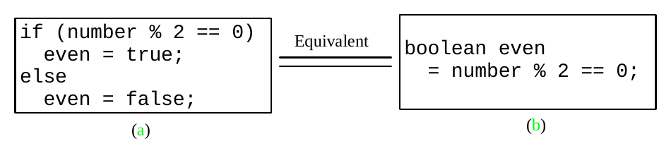
TIP
OOP · Java basics · 37

Slide 38
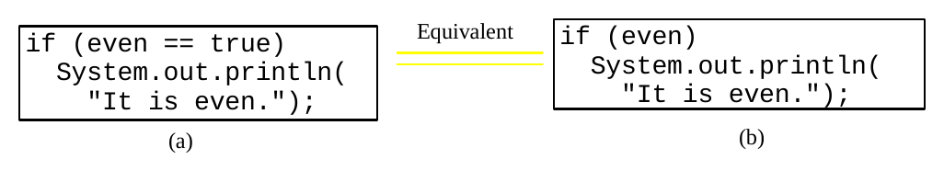
CAUTION
OOP · Java basics · 38

Slide 39
Logical Operators
Operator | Name
! | not
&& | and
|| | or
^ | exclusive or
OOP · Java basics · 39

Slide 40
Truth Table for Operator !
p | !p
true | false
false | true
Example (assume age = 24, gender = 'M')
!(age > 18) is false, because (age > 18) is true.
!(gender != 'F') is true, because (grade != 'F') is false.
OOP · Java basics · 40

Slide 41
Truth Table for Operator &&
p1 | p2 | p1 && p2
false | false | false
false | true | false
true | false | false
true | true | true
Example (assume age = 24, gender = 'F')
(age > 18) && (gender == 'F') is true, because (age > 18) and (gender == 'F') are both true.
(age > 18) && (gender != 'F') is false, because (gender != 'F') is false.
OOP · Java basics · 41

Slide 42
Truth Table for Operator ||
p1 | p2 | p1 || p2
false | false | false
false | true | true
true | false | true
true | true | true
Example (assume age = 24, gender = 'F')
(age > 34) || (gender == 'F') is true, because (gender == 'F') is true.
(age > 34) || (gender == 'M') is false, because (age > 34) and (gender == 'M') are both false.
OOP · Java basics · 42

Slide 43
Truth Table for Operator ^
p1 | p2 | p1 ^ p2
false | false | false
false | true | true
true | false | true
true | true | false
Example (assume age = 24, gender = 'F')
(age > 34) ^ (gender == 'F') is true, because (age > 34) is false but (gender == 'F') is true.
(age > 34) || (gender == 'M') is false, because (age > 34) and (gender == 'M') are both false.
OOP · Java basics · 43

Slide 44
Examples
System.out.println("Is " + number + " divisible by 2 and 3? " +
((number % 2 == 0) && (number % 3 == 0)));
System.out.println("Is " + number + " divisible by 2 or 3? " +
((number % 2 == 0) || (number % 3 == 0)));
System.out.println("Is " + number +
" divisible by 2 or 3, but not both? " +
((number % 2 == 0) ^ (number % 3 == 0)));
▶ TestBooleanOperators
OOP · Java basics · 44

Slide 45
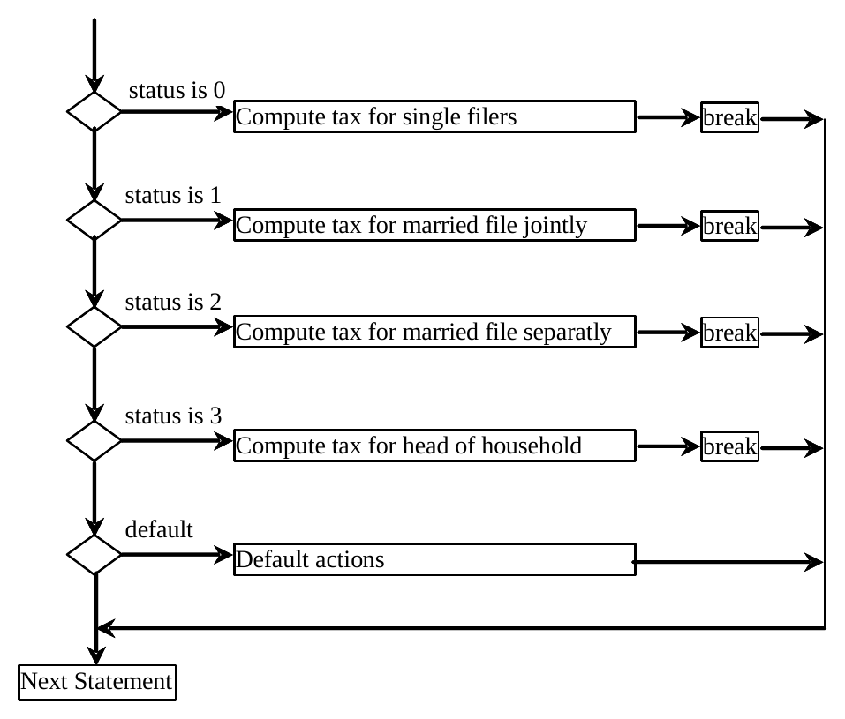
switch Statement Flow Chart
OOP · Java basics · 45

Slide 46
switch Statement Rules
The switch-expression must yield a value of char, byte, short, int, String or enum type and must always be enclosed in parentheses.
switch (switch-expression) {
case value1: statement(s)1;
break;
case value2: statement(s)2;
break;
...
case valueN: statement(s)N;
break;
default: statement(s)-for-default;
}
The value1, ..., and valueN must have the same data type as the value of the switch-expression. The resulting statements in the case statement are executed when the value in the case statement matches the value of the switch-expression. Note that value1, ..., and valueN are constant expressions, meaning that they cannot contain variables in the expression, such as 1 + x.
OOP · Java basics · 46

Slide 47
switch Statement Rules
The keyword break is optional, but it should be used at the end of each case in order to terminate the remainder of the switch statement. If the break statement is not present, the next case statement will be executed.
switch (switch-expression) {
case value1: statement(s)1;
break;
case value2: statement(s)2;
break;
...
case valueN: statement(s)N;
break;
default: statement(s)-for-default;
}
The default case, which is optional, can be used to perform actions when none of the specified cases matches the switch-expression.
The case statements are executed in sequential order, but the order of the cases (including the default case) does not matter. However, it is good programming style to follow the logical sequence of the cases and place the default case at the end.
OOP · Java basics · 47

Slide 48
Trace switch statement
switch (ch) {
case 'a': System.out.println(ch);
break;
case 'b': System.out.println(ch);
break;
case 'c': System.out.println(ch);
}
switch (ch) {
case 'a': System.out.println(ch);
case 'b': System.out.println(ch);
case 'c': System.out.println(ch);
}
OOP · Java basics · 48

Slide 49
Conditional Operator
if (x > 0)
y = 1
else
y = -1;
is equivalent to
y = (x > 0) ? 1 : -1;
(boolean-expression) ? expression1 : expression2
Ternary operator
Binary operator
Unary operator
OOP · Java basics · 49

Slide 50
Conditional Operator
if (num % 2 == 0)
System.out.println(num + "is even");
else
System.out.println(num + "is odd");
System.out.println(
(num % 2 == 0)? num + "is even" :
num + "is odd");
OOP · Java basics · 50

Slide 51
Formatting Output
▫ Use the printf statement.
System.out.printf(format, items);
▫ Where format is a string that may consist of substrings and format specifiers. A format specifier specifies how an item should be displayed. An item may be a numeric value, character, boolean value, or a string. Each specifier begins with a percent sign.
OOP · Java basics · 51

Slide 52
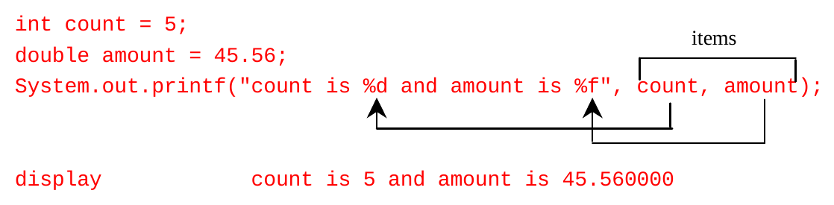
Frequently-Used Specifiers
Specifier | Output | Example
%b | a boolean value | true or false
%c | a character | 'a'
%d | a decimal integer | 200
%f | a floating-point number | 45.460000
%e | a number in standard scientific notation | 4.556000e+01
%s | a string | "Java is cool"
OOP · Java basics · 52

Slide 53
Operator Precedence
▫ var++, var--
▫ +, - (Unary plus and minus), ++var, --var
▫ (type) Casting
▫ ! (Not)
▫ *, /, % (Multiplication, division, and remainder)
▫ +, - (Binary addition and subtraction)
▫ <, <=, >, >= (Comparison)
▫ ==, != (Equality)
▫ ^ (Exclusive OR)
▫ && (Conditional AND) Short-circuit AND
▫ || (Conditional OR) Short-circuit OR
▫ =, +=, -=, *=, /=, %= (Assignment operator)
OOP · Java basics · 53

Slide 54
Operator Precedence and Associativity
The expression in the parentheses is evaluated first. (Parentheses can be nested, in which case the expression in the inner parentheses is executed first.) When evaluating an expression without parentheses, the operators are applied according to the precedence rule and the associativity rule.
If operators with the same precedence are next to each other, their associativity determines the order of evaluation. All binary operators except assignment operators are left-associative.
a - b + c - d is equivalent to ((a - b) + c) - d
Assignment operators are right-associative. Therefore, the expression
a = b += c = 5 is equivalent to a = (b += (c = 5))
OOP · Java basics · 54

Slide 55
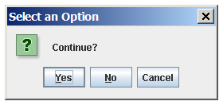
(GUI) Confirmation Dialogs
int option = JOptionPane.showConfirmDialog
(null, "Continue");
OOP · Java basics · 55

Slide 56
Mathematical Functions, Characters, and Strings
Java basics
OOP · Java basics · 56

Slide 57
Mathematical Functions and the Math Class
Java provides many useful methods in the Math class for performing common mathematical functions.
▫ Class constants:
– PI
– E
▫ Class methods:
– Trigonometric Methods
– Exponent Methods
– Rounding Methods
– min, max, abs, and random Methods
OOP · Java basics · 57

Slide 58
Trigonometric Methods
sin(double a)
cos(double a)
tan(double a)
acos(double a)
asin(double a)
atan(double a)
Radians
toRadians(90)
Examples:
Math.sin(0) returns 0.0
Math.sin(Math.PI / 6)
returns 0.5
Math.sin(Math.PI / 2)
returns 1.0
Math.cos(0) returns 1.0
Math.cos(Math.PI / 6)
returns 0.866
Math.cos(Math.PI / 2)
returns 0
OOP · Java basics · 58

Slide 59
Exponent Methods
exp(double a)
Returns e raised to the power of a.
log(double a)
Returns the natural logarithm of a.
log10(double a)
Returns the 10-based logarithm of a.
pow(double a, double b)
Returns a raised to the power of b.
sqrt(double a)
Returns the square root of a.
Examples:
Math.exp(1) returns 2.71
Math.log(2.71) returns 1.0
Math.pow(2, 3) returns 8.0
Math.pow(3, 2) returns 9.0
Math.pow(3.5, 2.5) returns
22.91765
Math.sqrt(4) returns 2.0
Math.sqrt(10.5) returns 3.24
OOP · Java basics · 59

Slide 60
Rounding Methods
double ceil(double x)
x rounded up to its nearest integer. This integer is returned as a double value.
double floor(double x)
x is rounded down to its nearest integer. This integer is returned as a double value.
double rint(double x)
x is rounded to its nearest integer. If x is equally close to two integers, the even one is returned as a double.
int round(float x)
Return (int)Math.floor(x+0.5).
long round(double x)
Return (long)Math.floor(x+0.5).
OOP · Java basics · 60

Slide 61
Rounding Methods Examples
Math.ceil(2.1) returns 3.0
Math.ceil(2.0) returns 2.0
Math.ceil(-2.0) returns -2.0
Math.ceil(-2.1) returns -2.0
Math.floor(2.1) returns 2.0
Math.floor(2.0) returns 2.0
Math.floor(-2.0) returns -2.0
Math.floor(-2.1) returns -3.0
Math.rint(2.1) returns 2.0
Math.rint(2.0) returns 2.0
Math.rint(-2.0) returns -2.0
Math.rint(-2.1) returns -2.0
Math.rint(2.5) returns 2.0
Math.rint(-2.5) returns -2.0
Math.round(2.6f) returns 3
Math.round(2.0) returns 2
Math.round(-2.0f) returns -2
Math.round(-2.6) returns -3
OOP · Java basics · 61

Slide 62
min, max, and abs
max(a, b) and min(a, b)
Returns the maximum or minimum of two parameters.
abs(a)
Returns the absolute value of the parameter.
random()
Returns a random double value in the range [0.0, 1.0).
Examples:
Math.max(2, 3) returns 3
Math.max(2.5, 3) returns
3.0
Math.min(2.5, 3.6)
returns 2.5
Math.abs(-2) returns 2
Math.abs(-2.1) returns
2.1
OOP · Java basics · 62

Slide 63
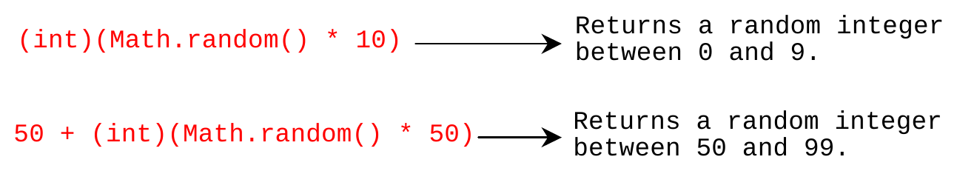
The random Method
Generates a random double value greater than or equal to 0.0 and less than 1.0 (0 <= Math.random() < 1.0).
Examples:
In general,
OOP · Java basics · 63

Slide 64
Character Data Type
char letter = 'A'; (ASCII)
char numChar = '4'; (ASCII)
char letter = '\u0041'; (Unicode)
char numChar = '\u0034'; (Unicode)
Four hexadecimal digits.
NOTE: The increment and decrement operators can also be used on char variables to get the next or preceding Unicode character. For example, the following statements display character b.
char ch = 'a';
System.out.println(++ch);
OOP · Java basics · 64

Slide 65
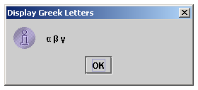
Unicode Format
Java characters use Unicode, a 16-bit encoding scheme established by the Unicode Consortium to support the interchange, processing, and display of written texts in the world’s diverse languages. Unicode takes two bytes, preceded by \u, expressed in four hexadecimal numbers that run from '\u0000' to '\uFFFF'. So, Unicode can represent 65535 + 1 characters.
Unicode \u03b1 \u03b2 \u03b3 for three Greek letters
OOP · Java basics · 65

Slide 66
Escape Sequences for Special Characters
Description | Escape Sequence | Unicode
Backspace | \b | \u0008
Tab | \t | \u0009
Linefeed | \n | \u000A
Carriage return | \r | \u000D
Backslash | \\ | \u005C
Single Quote | \' | \u0027
Double Quote | \" | \u0022
OOP · Java basics · 66

Slide 67
Casting between char and Numeric Types
int i = 'a'; // Same as int i = (int)'a';
char c = 97; // Same as char c = (char)97;
OOP · Java basics · 67

Slide 68
Comparing and Testing Characters
if (ch >= 'A' && ch <= 'Z')
System.out.println(ch + " is an uppercase letter");
else if (ch >= 'a' && ch <= 'z')
System.out.println(ch + " is a lowercase letter");
else if (ch >= '0' && ch <= '9')
System.out.println(ch + " is a numeric character");
OOP · Java basics · 68

Slide 69
Methods in the Character Class
Method | Description
isDigit(ch) | Returns true if the specified character is a digit.
isLetter(ch) | Returns true if the specified character is a letter.
isLetterOfDigit(ch) | Returns true if the specified character is a letter or digit.
isLowerCase(ch) | Returns true if the specified character is a lowercase letter.
isUpperCase(ch) | Returns true if the specified character is an uppercase letter.
toLowerCase(ch) | Returns the lowercase of the specified character.
toUpperCase(ch) | Returns the uppercase of the specified character.
OOP · Java basics · 69

Slide 70
The String Type
The char type only represents one character. To represent a string of characters, use the data type called String. For example,
String message = "Welcome to Java";
String is actually a predefined class in the Java library just like the System class and JOptionPane class. The String type is not a primitive type.
OOP · Java basics · 70

Slide 71
Simple Methods for String Objects
Method | Description
length() | Returns the number of characters in this string.
charAt(index) | Returns the character at the specified index from this string.
concat(s1) | Returns a new string that concatenates this string with string s1.
toUpperCase() | Returns a new string with all letters in uppercase.
toLowerCase() | Returns a new string with all letters in lowercase.
trim() | Returns a new string with whitespace characters trimmed on both sides.
OOP · Java basics · 71

Slide 72
Getting String Length
String message = "Welcome to Java";
System.out.println("The length of " + message + " is "
+ message.length());
OOP · Java basics · 72

Slide 73
String Concatenation
String s3 = s1.concat(s2); or String s3 = s1 + s2;
// Three strings are concatenated
String message = "Welcome " + "to " + "Java";
// String Chapter is concatenated with number 2
String s = "Chapter" + 2; // s becomes Chapter2
// String Supplement is concatenated with character B
String s1 = "Supplement" + 'B'; // s1 becomes SupplementB
OOP · Java basics · 73

Slide 74
Comparing Strings
Method | Description
equals(s1) | Returns true if this string is equal to string s1.
equalsIgnoreCase(s1) | Returns true if this string is equal to string s1; it is case insensitive.
compareTo(s1) | Returns an integer greater than 0, equal to 0, or less than 0 to indicate whether this string is greater than, equal to, or less than s1.
compareToIgnoreCase(s1) | Same as compareTo except that the comparison is case insensitive.
startsWith(prefix) | Returns true if this string starts with the specified prefix.
endsWith(suffix) | Returns true if this string ends with the specified suffix.
== | Never use == to compare strings: it compares references, not content. Use equals(s1).
▶ OrderTwoCities
OOP · Java basics · 74

Slide 75
Loops
Java basics
OOP · Java basics · 75

Slide 76
Problem: Printing “Welcome to Java” 100 times
System.out.println("Welcome to Java!");
System.out.println("Welcome to Java!");
System.out.println("Welcome to Java!");
System.out.println("Welcome to Java!");
System.out.println("Welcome to Java!");
System.out.println("Welcome to Java!");
...
...
...
System.out.println("Welcome to Java!");
System.out.println("Welcome to Java!");
System.out.println("Welcome to Java!");
100
times
OOP · Java basics · 76

Slide 77
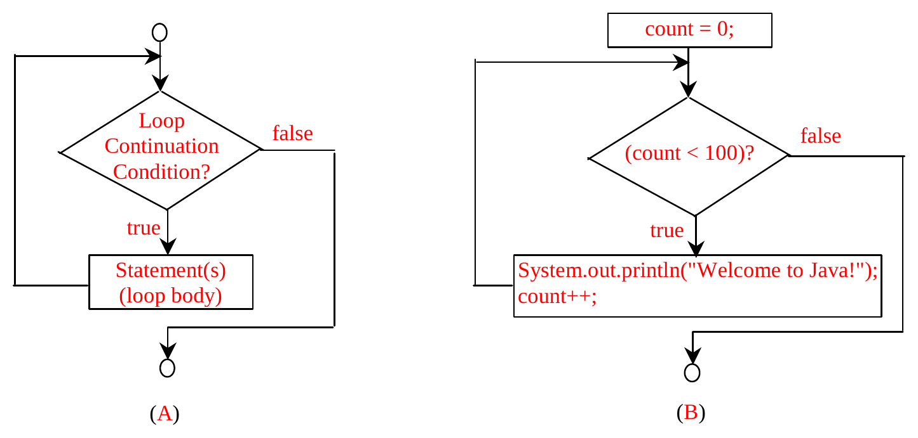
while Loop
while (loop-continuation-condition) {
// loop-body;
Statement(s);
}
int count = 0;
while (count < 100) {
System.out.println("Welcome to Java!");
count++;
}
OOP · Java basics · 77

Slide 78
Trace while Loop
Initialize count
int count = 0;
while (count < 2) {
System.out.println("Welcome to Java!");
count++;
}
OOP · Java basics · 78

Slide 79
Trace while Loop
(count < 2) is true
int count = 0;
while (count < 2) {
System.out.println("Welcome to Java!");
count++;
}
OOP · Java basics · 79

Slide 80
Trace while Loop
Print Welcome to Java
int count = 0;
while (count < 2) {
System.out.println("Welcome to Java!");
count++;
}
OOP · Java basics · 80

Slide 81
Trace while Loop
Increase count by 1
count is 1 now
int count = 0;
while (count < 2) {
System.out.println("Welcome to Java!");
count++;
}
OOP · Java basics · 81

Slide 82
Trace while Loop
(count < 2) is still true since count
is 1
int count = 0;
while (count < 2) {
System.out.println("Welcome to Java!");
count++;
}
OOP · Java basics · 82

Slide 83
Trace while Loop
Print Welcome to Java
int count = 0;
while (count < 2) {
System.out.println("Welcome to Java!");
count++;
}
OOP · Java basics · 83

Slide 84
Trace while Loop
Increase count by 1
count is 2 now
int count = 0;
while (count < 2) {
System.out.println("Welcome to Java!");
count++;
}
OOP · Java basics · 84

Slide 85
Trace while Loop
(count < 2) is false since count is 2
now
int count = 0;
while (count < 2) {
System.out.println("Welcome to Java!");
count++;
}
OOP · Java basics · 85

Slide 86
Trace while Loop
The loop exits. Execute the next
statement after the loop.
int count = 0;
while (count < 2) {
System.out.println("Welcome to Java!");
count++;
}
OOP · Java basics · 86

Slide 87
Ending a Loop with a Sentinel Value
Often the number of times a loop is executed is not predetermined. You may use an input value to signify the end of the loop. Such a value is known as a sentinel value.
Write a program that reads and calculates the sum of an unspecified number of integers. The input 0 signifies the end of the input.
▶ SentinelValue
OOP · Java basics · 87

Slide 88
Caution
Don’t use floating-point values for equality checking in a loop control. Since floating-point values are approximations for some values, using them could result in imprecise counter values and inaccurate results. Consider the following code for computing 1 + 0.9 + 0.8 + ... + 0.1:
double item = 1; double sum = 0;
while (item != 0) { // No guarantee item will be 0
sum += item;
item -= 0.1;
}
System.out.println(sum);
Variable item starts with 1 and is reduced by 0.1 every time the loop body is executed. The loop should terminate when item becomes 0. However, there is no guarantee that item will be exactly 0, because the floating-point arithmetic is approximated. This loop seems OK on the surface, but it is actually an infinite loop.
OOP · Java basics · 88

Slide 89
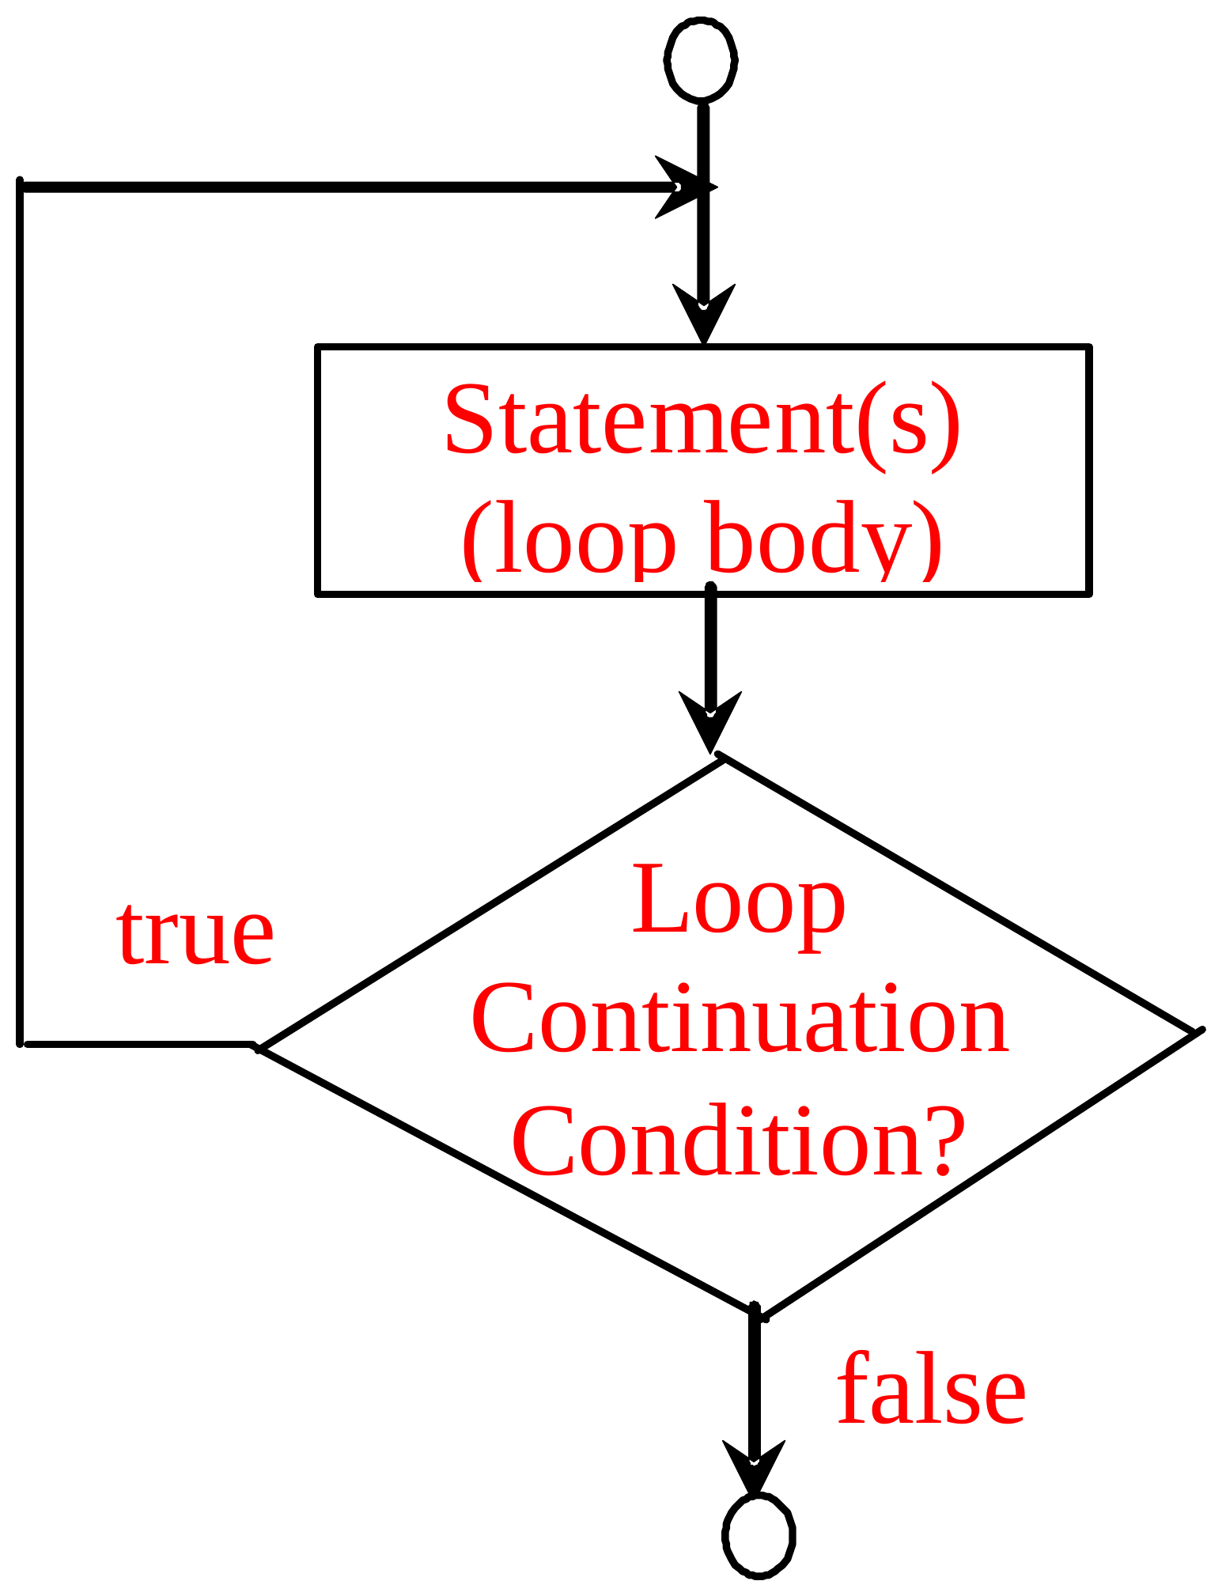
do-while Loop
do {
// Loop body;
Statement(s);
} while (loop-continuation-condition);
OOP · Java basics · 89

Slide 90
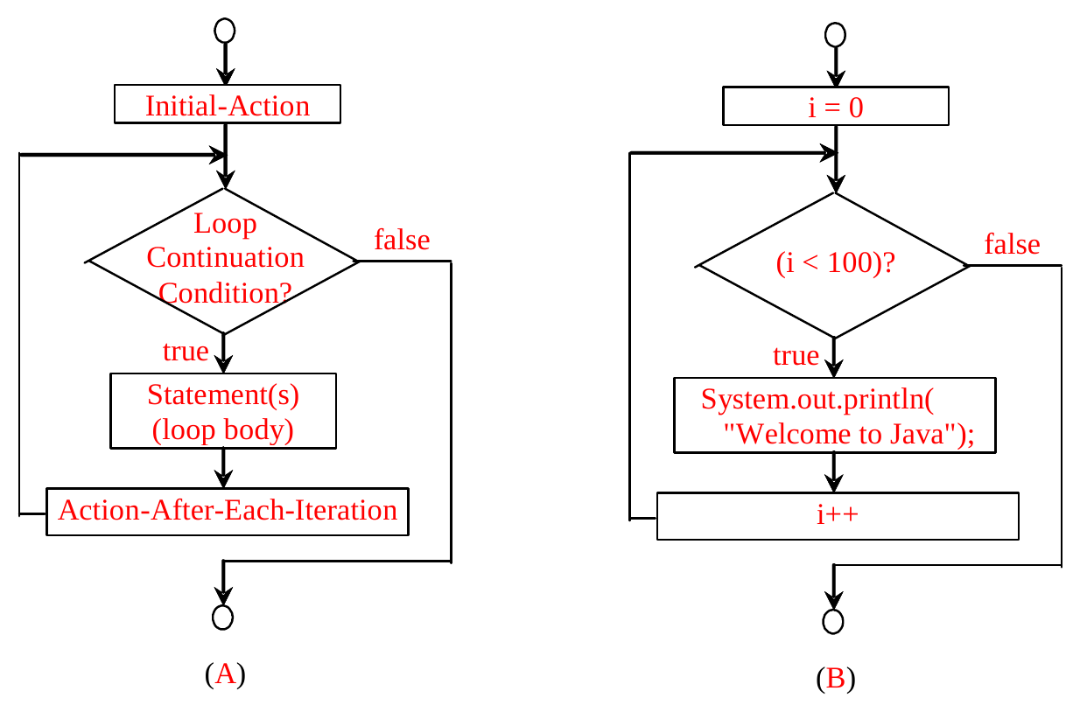
for Loops
for (initial-action; loop-continuation-condition;
action-after-each-iteration) {
// loop body;
Statement(s);
}
int i;
for (i = 0; i < 100; i++) {
System.out.println(
"Welcome to Java!");
}
OOP · Java basics · 90

Slide 91
Trace for Loop
Declare i
int i;
for (i = 0; i < 2; i++) {
System.out.println("Welcome to Java!");
}
OOP · Java basics · 91

Slide 92
Trace for Loop
Execute initializer
i is now 0
int i;
for (i = 0; i < 2; i++) {
System.out.println("Welcome to Java!");
}
OOP · Java basics · 92

Slide 93
Trace for Loop
(i < 2) is true
since i is 0
int i;
for (i = 0; i < 2; i++) {
System.out.println("Welcome to Java!");
}
OOP · Java basics · 93

Slide 94
Trace for Loop
Print Welcome to Java
int i;
for (i = 0; i < 2; i++) {
System.out.println("Welcome to Java!");
}
OOP · Java basics · 94

Slide 95
Trace for Loop
Execute adjustment statement
i now is 1
int i;
for (i = 0; i < 2; i++) {
System.out.println("Welcome to Java!");
}
OOP · Java basics · 95

Slide 96
Trace for Loop
(i < 2) is still true
since i is 1
int i;
for (i = 0; i < 2; i++) {
System.out.println("Welcome to Java!");
}
OOP · Java basics · 96

Slide 97
Trace for Loop
Print Welcome to Java
int i;
for (i = 0; i < 2; i++) {
System.out.println("Welcome to Java!");
}
OOP · Java basics · 97

Slide 98
Trace for Loop
Execute adjustment statement
i now is 2
int i;
for (i = 0; i < 2; i++) {
System.out.println("Welcome to Java!");
}
OOP · Java basics · 98

Slide 99
Trace for Loop
(i < 2) is false
since i is 2
int i;
for (i = 0; i < 2; i++) {
System.out.println("Welcome to Java!");
}
OOP · Java basics · 99

Slide 100
Trace for Loop
Exit the loop. Execute the next
statement after the loop
int i;
for (i = 0; i < 2; i++) {
System.out.println("Welcome to Java!");
}
OOP · Java basics · 100

Slide 101
Note
The initial-action in a for loop can be a list of zero or more comma-separated expressions. The action-after-each-iteration in a for loop can be a list of zero or more comma-separated statements. Therefore, the following two for loops are correct. They are rarely used in practice, however.
for (int i = 1; i < 100; System.out.println(i++));
for (int i = 0, j = 0; (i + j < 10); i++, j++) {
// Do something
}
OOP · Java basics · 101

Slide 102
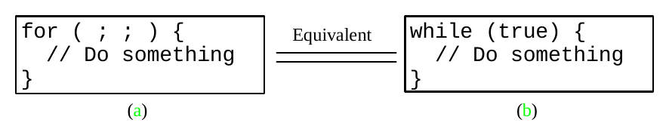
Note
If the loop-continuation-condition in a for loop is omitted, it is implicitly true.
Thus the statement given below in (a), which is an infinite loop, is correct.
Nevertheless, it is better to use the equivalent loop in (b) to avoid confusion:
OOP · Java basics · 102

Slide 103
Caution
Adding a semicolon at the end of the for clause before the loop body is a common mistake, as shown below:
Logic
Error
for (int i=0; i<10; i++);
{
System.out.println("i is " + i);
}
Similarly, the following loop is also wrong:
int i=0;
while (i < 10);
{
System.out.println("i is " + i);
i++;
}
OOP · Java basics · 103

Slide 104
Caution, cont.
In the case of the do loop, the following semicolon is needed to end the loop.
int i=0;
do {
System.out.println("i is " + i);
i++;
} while (i<10);
OOP · Java basics · 104

Slide 105
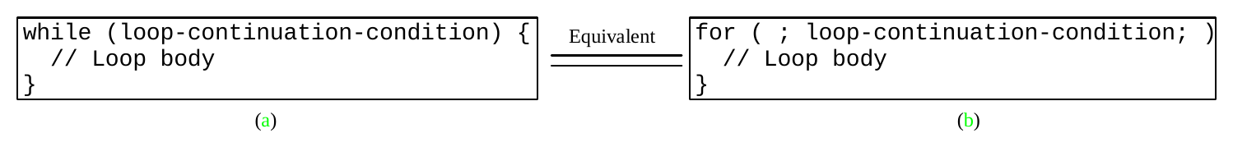
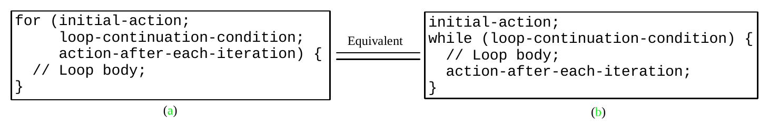
Which Loop to Use?
The three forms of loop statements, while, do-while, and for, are expressively equivalent.
For example, a while loop in (a) in the following figure can always be converted into the following for loop in (b):
▫ A for loop in (a) in the following figure can generally be converted into the following while loop in (b) except in certain special cases
OOP · Java basics · 105

Slide 106
Recommendations
Use the one that is most intuitive and comfortable for you. In general:
for loop may be used if the number of repetitions is known, as, for example, when you need to print a message 100 times
while loop may be used if the number of repetitions is not known, as in the case of reading the numbers until the input is 0
do-while loop can be used to replace a while loop if the loop body has to be executed before testing the continuation condition
OOP · Java basics · 106

Slide 107
Using break and continue
Examples for using the break and continue keywords:
public class TestBreak {
public static void main(String[] args) {
int sum = 0;
int number = 0;
while (number < 20) {
number++;
sum += number;
if (sum >= 100)
break;
}
System.out.println("The number is " + number);
System.out.println("The sum is " + sum);
}
}
public class TestContinue {
public static void main(String[] args) {
int sum = 0;
int number = 0;
while (number < 20) {
number++;
if (number == 10 || number == 11)
continue;
sum += number;
}
System.out.println("The sum is " + sum);
}
}
▶ TestBreak
▶ TestContinue
OOP · Java basics · 107

Slide 108
(GUI) Controlling a Loop with a Confirmation Dialog
A sentinel-controlled loop can be implemented using a confirmation dialog. The answers Yes or No to continue or terminate the loop. The template of the loop may look as follows:
int option = 0;
while (option == JOptionPane.YES_OPTION) {
System.out.println("continue loop");
option = JOptionPane.showConfirmDialog(null, "Continue?");
}
OOP · Java basics · 108

Slide 109
Methods
Java basics
OOP · Java basics · 109

Slide 110
Problem
Find the sum of integers from 1 to 10, from 20 to 30, and from 35 to 45, respectively.
int sum = 0;
for (int i = 1; i <= 10; i++)
sum += i;
System.out.println("Sum from 1 to 10 is " + sum);
sum = 0;
for (int i = 20; i <= 30; i++)
sum += i;
System.out.println("Sum from 20 to 30 is " + sum);
sum = 0;
for (int i = 35; i <= 45; i++)
sum += i;
System.out.println("Sum from 35 to 45 is " + sum);
OOP · Java basics · 110

Slide 111
Solution
public static int sum(int i1, int i2) {
int sum = 0;
for (int i = i1; i <= i2; i++)
sum += i;
return sum;
}
public static void main(String[] args) {
System.out.println("Sum from 1 to 10 is " + sum(1, 10));
System.out.println("Sum from 20 to 30 is " + sum(20, 30));
System.out.println("Sum from 35 to 45 is " + sum(35, 45));
}
OOP · Java basics · 111

Slide 112
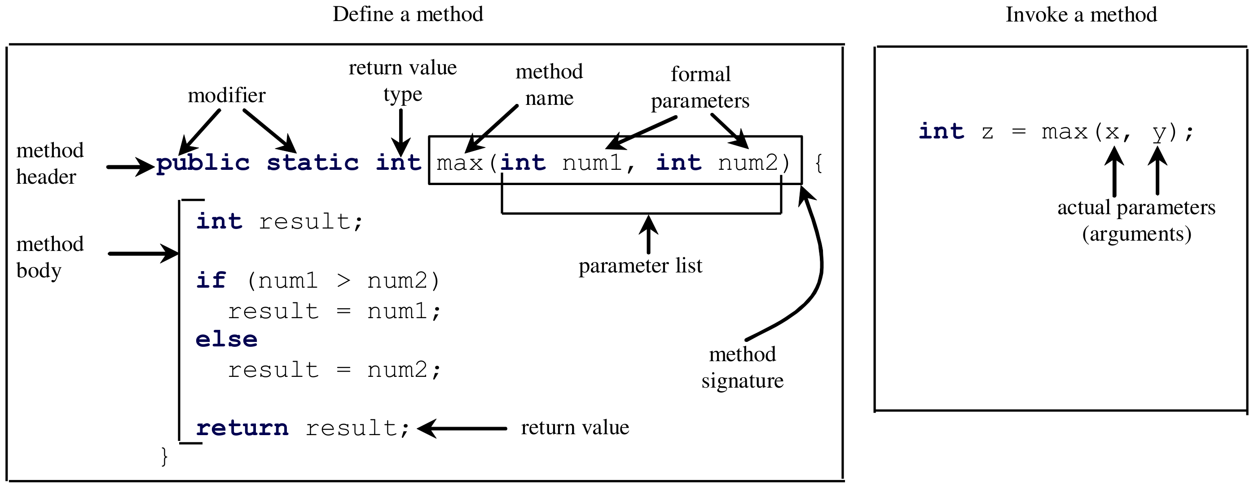
Defining Methods
A method is a collection of statements that are grouped together to perform an operation.
OOP · Java basics · 112

Slide 113
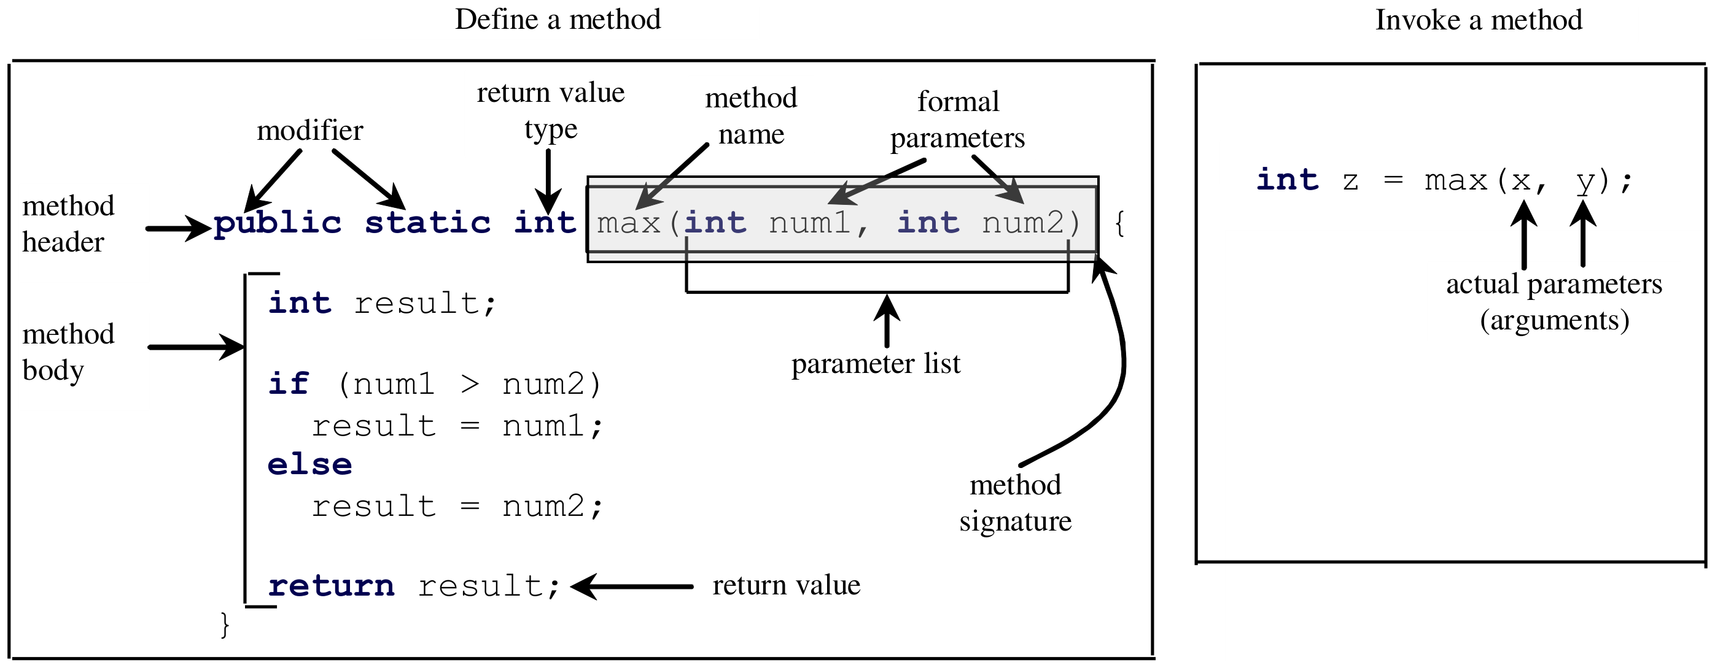
Method Signature
Method signature is the combination of the method name and the parameter list.
OOP · Java basics · 113

Slide 114
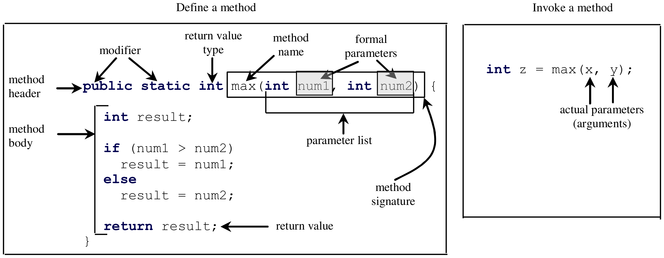
Formal Parameters
The variables defined in the method header are known as formal parameters.
OOP · Java basics · 114

Slide 115
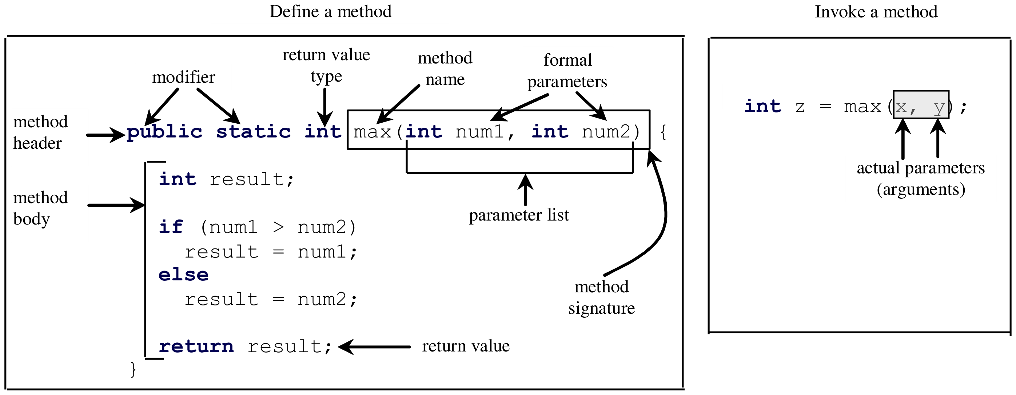
Actual Parameters
When a method is invoked, you pass a value to the parameter. This value is referred to as actual parameter or argument.
OOP · Java basics · 115

Slide 116
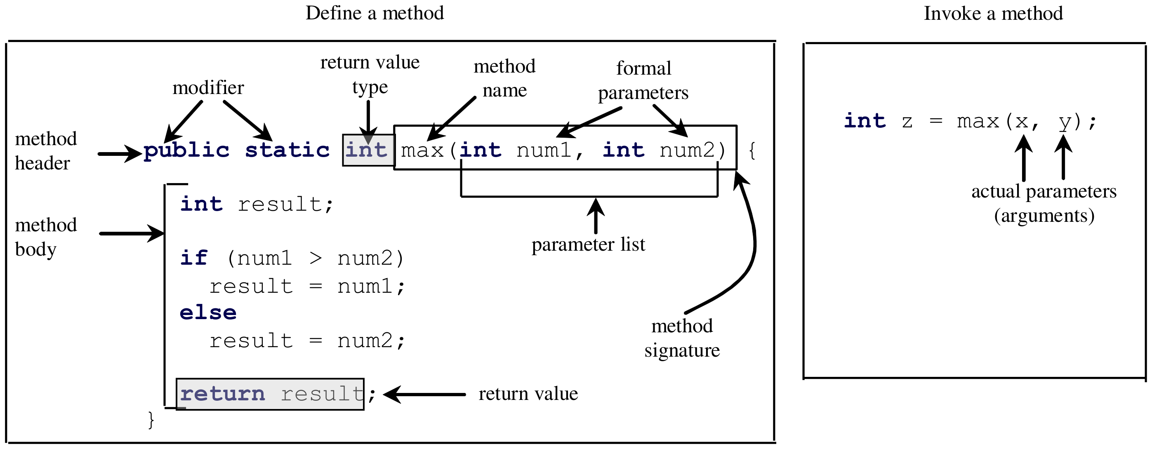
Return Value Type
A method may return a value. The returnValueType is the data type of the value the method returns. If the method does not return a value, the returnValueType is the keyword void. For example, the returnValueType in the main method is void.
OOP · Java basics · 116

Slide 117
Calling Methods
Testing the max method
This program demonstrates calling a method max to return the largest of the int values
▶ TestMax
OOP · Java basics · 117

Slide 118
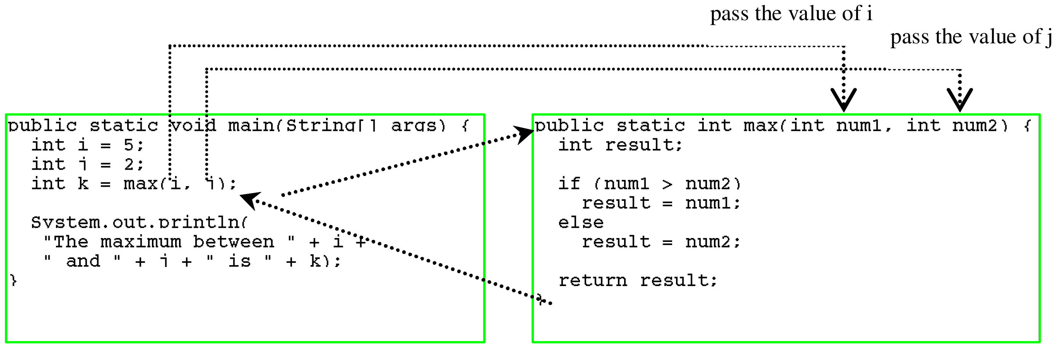
Calling Methods, cont.
OOP · Java basics · 118

Slide 119
Trace Method Invocation
i is now 5
public static void main(String[] args) {
int i = 5;
int j = 2;
int k = max(i, j);
System.out.println(
"The maximum between " + i +
" and " + j + " is " + k);
}
public static int max(int num1, int num2) {
int result;
if (num1 > num2)
result = num1;
else
result = num2;
return result;
}
OOP · Java basics · 119

Slide 120
Trace Method Invocation
j is now 2
public static void main(String[] args) {
int i = 5;
int j = 2;
int k = max(i, j);
System.out.println(
"The maximum between " + i +
" and " + j + " is " + k);
}
public static int max(int num1, int num2) {
int result;
if (num1 > num2)
result = num1;
else
result = num2;
return result;
}
OOP · Java basics · 120

Slide 121
Trace Method Invocation
invoke max(i, j)
public static void main(String[] args) {
int i = 5;
int j = 2;
int k = max(i, j);
System.out.println(
"The maximum between " + i +
" and " + j + " is " + k);
}
public static int max(int num1, int num2) {
int result;
if (num1 > num2)
result = num1;
else
result = num2;
return result;
}
OOP · Java basics · 121

Slide 122
Trace Method Invocation
invoke max(i, j)
Pass the value of i to num1
Pass the value of j to num2
public static void main(String[] args) {
int i = 5;
int j = 2;
int k = max(i, j);
System.out.println(
"The maximum between " + i +
" and " + j + " is " + k);
}
public static int max(int num1, int num2) {
int result;
if (num1 > num2)
result = num1;
else
result = num2;
return result;
}
OOP · Java basics · 122

Slide 123
Trace Method Invocation
declare variable result
public static void main(String[] args) {
int i = 5;
int j = 2;
int k = max(i, j);
System.out.println(
"The maximum between " + i +
" and " + j + " is " + k);
}
public static int max(int num1, int num2) {
int result;
if (num1 > num2)
result = num1;
else
result = num2;
return result;
}
OOP · Java basics · 123

Slide 124
Trace Method Invocation
(num1 > num2) is true since num1
is 5 and num2 is 2
public static void main(String[] args) {
int i = 5;
int j = 2;
int k = max(i, j);
System.out.println(
"The maximum between " + i +
" and " + j + " is " + k);
}
public static int max(int num1, int num2) {
int result;
if (num1 > num2)
result = num1;
else
result = num2;
return result;
}
OOP · Java basics · 124

Slide 125
Trace Method Invocation
result is now 5
public static void main(String[] args) {
int i = 5;
int j = 2;
int k = max(i, j);
System.out.println(
"The maximum between " + i +
" and " + j + " is " + k);
}
public static int max(int num1, int num2) {
int result;
if (num1 > num2)
result = num1;
else
result = num2;
return result;
}
OOP · Java basics · 125

Slide 126
Trace Method Invocation
return result, which is 5
public static void main(String[] args) {
int i = 5;
int j = 2;
int k = max(i, j);
System.out.println(
"The maximum between " + i +
" and " + j + " is " + k);
}
public static int max(int num1, int num2) {
int result;
if (num1 > num2)
result = num1;
else
result = num2;
return result;
}
OOP · Java basics · 126

Slide 127
Trace Method Invocation
return max(i, j) and assign the
return value to k
public static void main(String[] args) {
int i = 5;
int j = 2;
int k = max(i, j);
System.out.println(
"The maximum between " + i +
" and " + j + " is " + k);
}
public static int max(int num1, int num2) {
int result;
if (num1 > num2)
result = num1;
else
result = num2;
return result;
}
OOP · Java basics · 127

Slide 128
Trace Method Invocation
Execute the print statement
public static void main(String[] args) {
int i = 5;
int j = 2;
int k = max(i, j);
System.out.println(
"The maximum between " + i +
" and " + j + " is " + k);
}
public static int max(int num1, int num2) {
int result;
if (num1 > num2)
result = num1;
else
result = num2;
return result;
}
OOP · Java basics · 128

Slide 129
CAUTION
A return statement is required for a value-returning method. The method shown below in (a) is logically correct, but it has a compilation error because the Java compiler thinks it possible that this method does not return any value.
public static int sign(int n) {
if (n > 0)
return 1;
else if (n == 0)
return 0;
else if (n < 0)
return -1;
}
public static int sign(int n) {
if (n > 0)
return 1;
else if (n == 0)
return 0;
else
return -1;
}
Should be
(a)
(b)
To fix this problem, delete if (n < 0) in (a), so that the compiler will see a return statement to be reached regardless of how the if statement is evaluated.
OOP · Java basics · 129

Slide 130
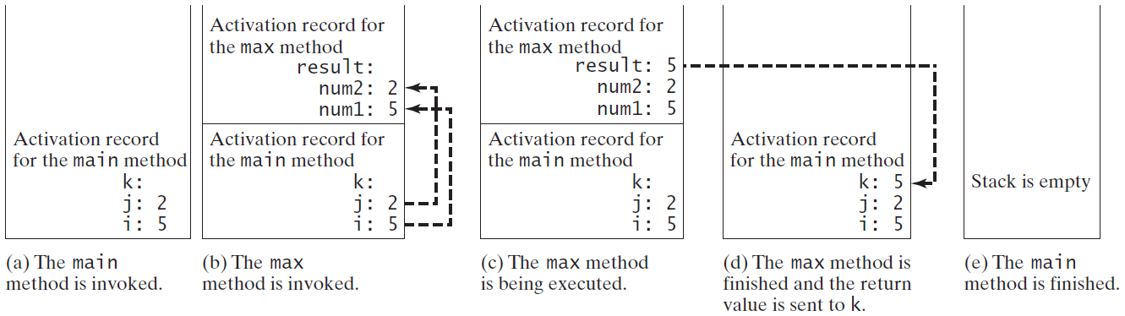
Call Stacks
OOP · Java basics · 130

Slide 131
Trace Call Stack
i is declared and initialized
public static void main(String[] args) {
int i = 5;
int j = 2;
int k = max(i, j);
System.out.println(
"The maximum between " + i +
" and " + j + " is " + k);
}
public static int max(int num1, int num2) {
int result;
if (num1 > num2)
result = num1;
else
result = num2;
return result;
}
i: 5
The main method
is invoked.
OOP · Java basics · 131

Slide 132
Trace Call Stack
j is declared and initialized
public static void main(String[] args) {
int i = 5;
int j = 2;
int k = max(i, j);
System.out.println(
"The maximum between " + i +
" and " + j + " is " + k);
}
public static int max(int num1, int num2) {
int result;
if (num1 > num2)
result = num1;
else
result = num2;
return result;
}
j: 2
i: 5
The main method
is invoked.
OOP · Java basics · 132

Slide 133
Trace Call Stack
Declare k
public static void main(String[] args) {
int i = 5;
int j = 2;
int k = max(i, j);
System.out.println(
"The maximum between " + i +
" and " + j + " is " + k);
}
public static int max(int num1, int num2) {
int result;
if (num1 > num2)
result = num1;
else
result = num2;
return result;
}
Space required for the main method
k:
j: 2
i: 5
The main method
is invoked.
OOP · Java basics · 133

Slide 134
Trace Call Stack
Invoke max(i, j)
public static void main(String[] args) {
int i = 5;
int j = 2;
int k = max(i, j);
System.out.println(
"The maximum between " + i +
" and " + j + " is " + k);
}
public static int max(int num1, int num2) {
int result;
if (num1 > num2)
result = num1;
else
result = num2;
return result;
}
Space required for the main method
k:
j: 2
i: 5
The main method
is invoked.
OOP · Java basics · 134

Slide 135
Trace Call Stack
pass the values of i and j to num1
and num2
public static void main(String[] args) {
int i = 5;
int j = 2;
int k = max(i, j);
System.out.println(
"The maximum between " + i +
" and " + j + " is " + k);
}
num2: 2
num1: 5
public static int max(int num1, int num2) {
int result;
if (num1 > num2)
result = num1;
else
result = num2;
return result;
}
Space required for the main method
k:
j: 2
i: 5
The max method is
invoked.
OOP · Java basics · 135

Slide 136
Trace Call Stack
Declare result
public static void main(String[] args) {
int i = 5;
int j = 2;
int k = max(i, j);
System.out.println(
"The maximum between " + i +
" and " + j + " is " + k);
}
result:
num2: 2
num1: 5
public static int max(int num1, int num2) {
int result;
if (num1 > num2)
result = num1;
else
result = num2;
return result;
}
Space required for the main method
k:
j: 2
i: 5
The max method is
invoked.
OOP · Java basics · 136

Slide 137
Trace Call Stack
(num1 > num2) is true
public static void main(String[] args) {
int i = 5;
int j = 2;
int k = max(i, j);
System.out.println(
"The maximum between " + i +
" and " + j + " is " + k);
}
result:
num2: 2
num1: 5
public static int max(int num1, int num2) {
int result;
if (num1 > num2)
result = num1;
else
result = num2;
return result;
}
Space required for the main method
k:
j: 2
i: 5
The max method is
invoked.
OOP · Java basics · 137

Slide 138
Trace Call Stack
Assign num1 to result
public static void main(String[] args) {
int i = 5;
int j = 2;
int k = max(i, j);
System.out.println(
"The maximum between " + i +
" and " + j + " is " + k);
}
Space required for the max method
result: 5
num2: 2
num1: 5
public static int max(int num1, int num2) {
int result;
if (num1 > num2)
result = num1;
else
result = num2;
return result;
}
Space required for the main method
k:
j: 2
i: 5
The max method is
invoked.
OOP · Java basics · 138

Slide 139
Trace Call Stack
Return result and assign it to k
public static void main(String[] args) {
int i = 5;
int j = 2;
int k = max(i, j);
System.out.println(
"The maximum between " + i +
" and " + j + " is " + k);
}
Space required for the max method
result: 5
num2: 2
num1: 5
public static int max(int num1, int num2) {
int result;
if (num1 > num2)
result = num1;
else
result = num2;
return result;
}
Space required for the main method
k: 5
j: 2
i: 5
The max method is
invoked.
OOP · Java basics · 139

Slide 140
Trace Call Stack
Execute print statement
public static void main(String[] args) {
int i = 5;
int j = 2;
int k = max(i, j);
System.out.println(
"The maximum between " + i +
" and " + j + " is " + k);
}
public static int max(int num1, int num2) {
int result;
if (num1 > num2)
result = num1;
else
result = num2;
return result;
}
Space required for the main method
k: 5
j: 2
i: 5
The main method
is invoked.
OOP · Java basics · 140

Slide 141
void Method Example
This type of method does not return a value. The method performs some actions.
▶ TestVoidMethod
▶ TestReturnGradeMethod
OOP · Java basics · 141

Slide 142
Passing Parameters
public static void nPrintln(String message, int n) {
for (int i = 0; i < n; i++)
System.out.println(message);
}
Suppose you invoke the method using
nPrintln("Welcome to Java", 5);
What is the output?
Suppose you invoke the method using
nPrintln("Computer Science", 15);
What is the output?
Can you invoke the method using
nPrintln(15, "Computer Science");
OOP · Java basics · 142

Slide 143
Pass by Value
Testing Pass by value
This program demonstrates passing values to the methods.
▶ Increment
▶ TestPassByValue
OOP · Java basics · 143

Slide 144
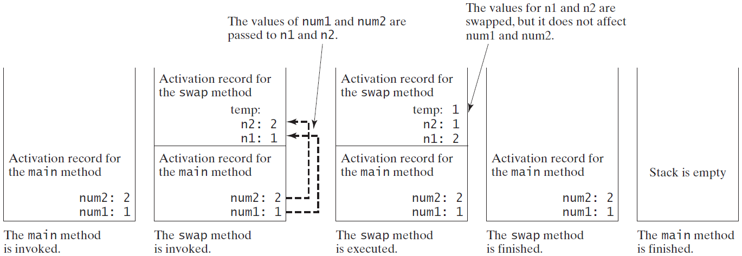
Pass by Value, cont.
OOP · Java basics · 144

Slide 145
Modularizing Code
Methods can be used to reduce redundant coding and enable code reuse.
Methods can also be used to modularize code and improve the quality of the program.
▶ GreatestCommonDivisorMethod
▶ PrimeNumberMethod
OOP · Java basics · 145

Slide 146
Overloading Methods
Overloading the max Method
public static double max(double num1, double num2) {
if (num1 > num2)
return num1;
else
return num2;
}
▶ TestMethodOverloading
OOP · Java basics · 146

Slide 147
Ambiguous Invocation
public class AmbiguousOverloading {
public static void main(String[] args) {
System.out.println(max(1, 2));
}
public static double max(int num1, double num2) {
if (num1 > num2)
return num1;
else
return num2;
}
public static double max(double num1, int num2) {
if (num1 > num2)
return num1;
else
return num2;
}
}
OOP · Java basics · 147

Slide 148
Scope of Local Variables
▫ A local variable: a variable defined inside a method.
▫ Scope: the part of the program where the variable can be referenced.
▫ The scope of a local variable starts from its declaration and continues to the end of the block that contains the variable. A local variable must be declared before it can be used.
OOP · Java basics · 148

Slide 149
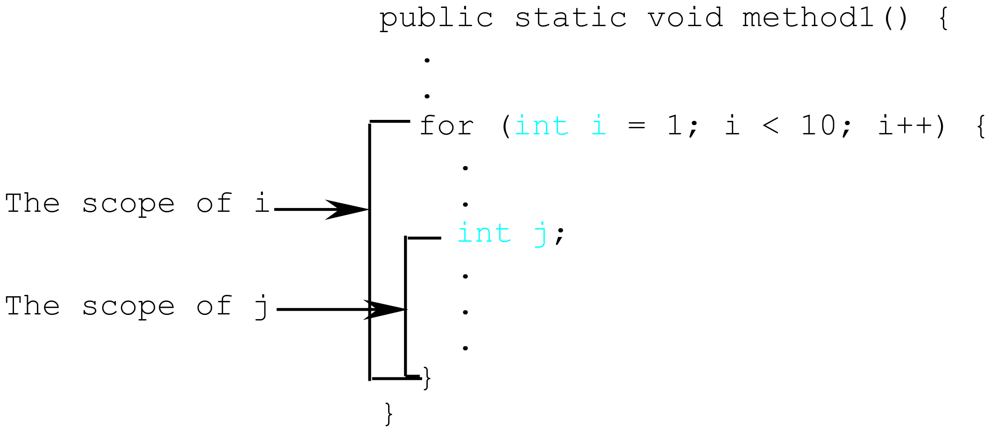
Scope of Local Variables, cont.
A variable declared in the initial action part of a for loop header has its scope in the entire loop. But a variable declared inside a for loop body has its scope limited in the loop body from its declaration and to the end of the block that contains the variable.
OOP · Java basics · 149

Slide 150
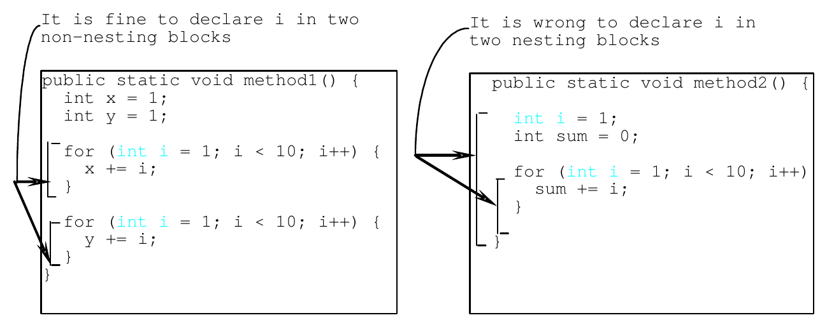
Scope of Local Variables, cont.
You can declare a local variable with the same name multiple times in different non-nesting blocks in a method, but you cannot declare a local variable twice in nested blocks.
OOP · Java basics · 150

Slide 151
Static Fields
▫ Static field (class variable): a variable declared static, inside a class but outside any method. Java has no global variables.
▫ This variable can be accessed by all the methods inside the class.
OOP · Java basics · 151

Slide 152
Static Fields vs Local Variables
public class StaticVsLocal {
static int x=8;
public static void main(String[] args) {
System.out.println(x);
test();
System.out.println(x);
t2();
System.out.println(x);
}
public static void test(){
int x=3;
++x;
System.out.println("Local x: "+x);
}
public static void t2(){
x=7;
x--;
System.out.println("Static x: "+x);
}
}
Output
8
Local x: 4
8
Static x: 6
6
OOP · Java basics · 152

Slide 153
Benefits of Methods
▫ Write a method once and reuse it anywhere.
▫ Information hiding. Hide the implementation from the user.
▫ Reduce complexity.
OOP · Java basics · 153

Slide 154
Single-Dimensional Arrays
Java basics
OOP · Java basics · 154

Slide 155
Opening Problem
Read one hundred numbers, compute their average, and find out how many numbers are above the average.
OOP · Java basics · 155

Slide 156
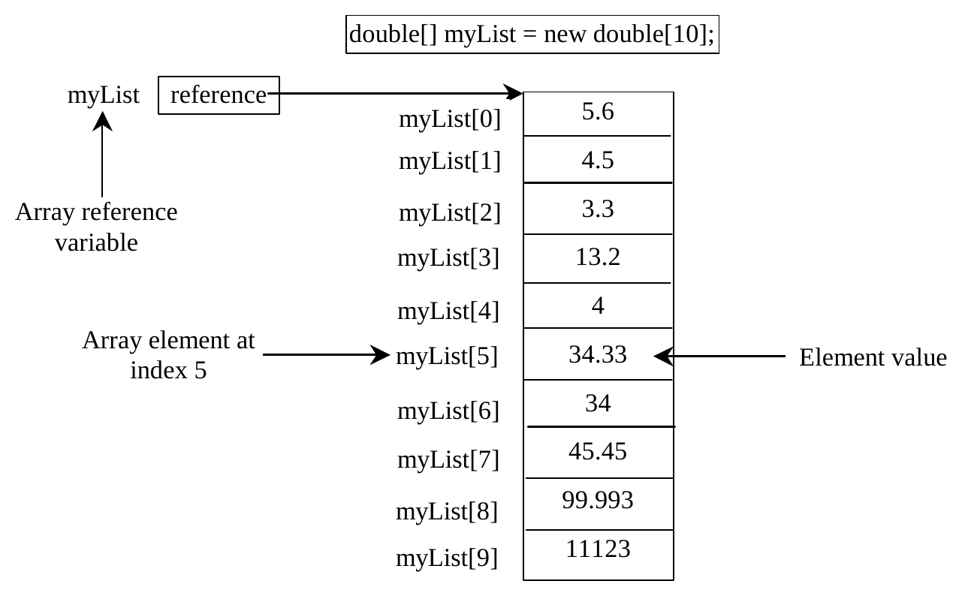
Introducing Arrays
Array is a data structure that represents a collection of the same types of data.
OOP · Java basics · 156

Slide 157
Declaring Array Variables
datatype[] arrayRefVar;
Example:
double[] myList;
datatype arrayRefVar[]; // This style is allowed, but not preferred
Example:
double myList[];
OOP · Java basics · 157

Slide 158
Creating Arrays
arrayRefVar = new datatype[arraySize];
Example:
myList = new double[10];
myList[0] references the first element in the array.
myList[9] references the last element in the array.
OOP · Java basics · 158

Slide 159
Declaring and Creating in One Step
datatype[] arrayRefVar = new datatype[arraySize];
double[] myList = new double[10];
datatype arrayRefVar[] = new datatype[arraySize];
double myList[] = new double[10];
OOP · Java basics · 159

Slide 160
The Length of an Array
Once an array is created, its size is fixed. It cannot be changed. You can find its size using
arrayRefVar.length
For example,
myList.length returns 10
OOP · Java basics · 160

Slide 161
Default Values
When an array is created, its elements are assigned the default value of
▫ 0 for the numeric primitive data types,
▫ '\u0000' for char types, and
▫ false for boolean types.
OOP · Java basics · 161

Slide 162
Indexed Variables
The array elements are accessed through the index. The array indices are 0-based, i.e., it starts from 0 to arrayRefVar.length-1.
Each element in the array is represented using the following syntax, known as an indexed variable:
arrayRefVar[index];
After an array is created, an indexed variable can be used in the same way as a regular variable.
For example, the following code adds the value in myList[0] and myList[1] to myList[2].
myList[2] = myList[0] + myList[1];
OOP · Java basics · 162

Slide 163
Array Initializers
Declaring, creating, initializing in one step:
double[] myList = {1.9, 2.9, 3.4, 3.5};
This shorthand syntax must be in one statement. This shorthand notation is equivalent to the following statements:
double[] myList = new double[4];
myList[0] = 1.9;
myList[1] = 2.9;
myList[2] = 3.4;
myList[3] = 3.5;
OOP · Java basics · 163

Slide 164
CAUTION
Using the shorthand notation, you have to declare, create, and initialize the array all in one statement. Splitting it would cause a syntax error. For example, the following is wrong:
double[] myList;
myList = {1.9, 2.9, 3.4, 3.5};
OOP · Java basics · 164

Slide 165
Processing Arrays
Initializing arrays with input values
java.util.Scanner input = new java.util.Scanner(System.in);
System.out.print("Enter " + myList.length + " values: ");
for (int i = 0; i < myList.length; i++)
myList[i] = input.nextDouble();
Initializing arrays with random values
for (int i = 0; i < myList.length; i++) {
myList[i] = Math.random() * 100;
}
Printing arrays
for (int i = 0; i < myList.length; i++) {
System.out.print(myList[i] + " ");
}
OOP · Java basics · 165

Slide 166
Processing Arrays
Summing all elements
double total = 0;
for (int i = 0; i < myList.length; i++) {
total += myList[i];
}
Finding the largest element
double max = myList[0];
for (int i = 1; i < myList.length; i++) {
if (myList[i] > max) max = myList[i];
}
OOP · Java basics · 166

Slide 167
Enhanced for Loop (for-each loop)
JDK 1.5 introduced a new for loop that enables you to traverse the complete array sequentially without using an index variable. For example, the following code displays all elements in the array myList:
for (double value: myList)
System.out.println(value);
In general, the syntax is
for (elementType value: arrayRefVar) {
// Process the value
}
You still have to use an index variable if you wish to traverse the array in a different order or change the elements in the array.
OOP · Java basics · 167

Slide 168
Copying Arrays
Using a loop:
int[] sourceArray = {2, 3, 1, 5, 10};
int[] targetArray = new int[sourceArray.length];
for (int i = 0; i < sourceArray.length; i++)
targetArray[i] = sourceArray[i];
The arraycopy Utility
arraycopy(sourceArray, src_pos, targetArray, tar_pos, length);
Example:
System.arraycopy(sourceArray, 0, targetArray, 0, sourceArray.length);
OOP · Java basics · 168

Slide 169
Passing Arrays to Methods
public static void printArray(int[] array) {
for (int i = 0; i < array.length; i++) {
System.out.print(array[i] + " ");
}
}
Invoke the method
int[] list = {3, 1, 2, 6, 4, 2};
printArray(list);
Invoke the method
printArray(new int[]{3, 1, 2, 6, 4, 2});
Anonymous array
OOP · Java basics · 169

Slide 170
Anonymous Array
The statement
printArray(new int[]{3, 1, 2, 6, 4, 2});
creates an array using the following syntax:
new dataType[]{literal0, literal1, ..., literalk};
There is no explicit reference variable for the array. Such array is called an anonymous array.
OOP · Java basics · 170

Slide 171
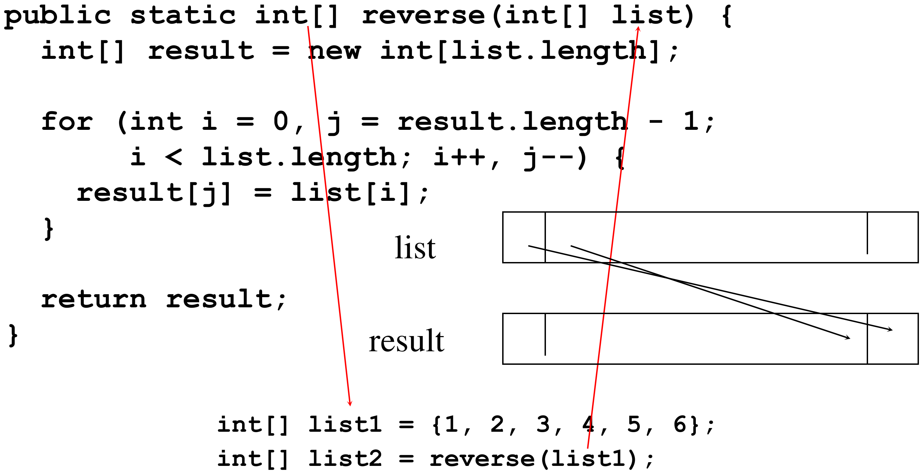
Returning an Array from a Method
OOP · Java basics · 171

Slide 172
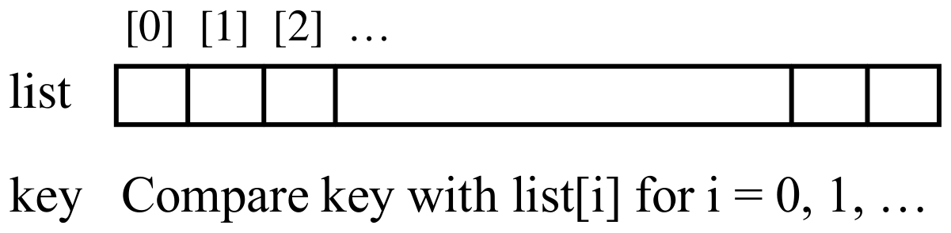
Searching Arrays
Searching is the process of looking for a specific element in an array; for example, discovering whether a certain score is included in a list of scores. Searching is a common task in computer programming. There are many algorithms and data structures devoted to searching. In this section, two commonly used approaches are discussed, linear search and binary search.
public class LinearSearch {
/** The method for finding a key in the list */
public static int linearSearch(int[] list, int key) {
for (int i = 0; i < list.length; i++)
if (key == list[i])
return i;
return -1;
}
}
OOP · Java basics · 172

Slide 173
The Arrays.binarySearch Method
Since binary search is frequently used in programming, Java provides several overloaded binarySearch methods for searching a key in an array of int, double, char, short, long, and float in the java.util.Arrays class. For example, the following code searches the keys in an array of numbers and an array of characters.
int[] list = {2, 4, 7, 10, 11, 45, 50, 59, 60, 66, 69, 70, 79};
System.out.println("Index is " +
java.util.Arrays.binarySearch(list, 11));
char[] chars = {'a', 'c', 'g', 'x', 'y', 'z'};
System.out.println("Index is " +
java.util.Arrays.binarySearch(chars, 't'));
For the binarySearch method to work, the array must be pre-sorted in increasing order.
OOP · Java basics · 173

Slide 174
The Arrays.sort Method
Since sorting is frequently used in programming, Java provides several overloaded sort methods for sorting an array of int, double, char, short, long, and float in the java.util.Arrays class. For example, the following code sorts an array of numbers and an array of characters.
double[] numbers = {6.0, 4.4, 1.9, 2.9, 3.4, 3.5};
java.util.Arrays.sort(numbers);
char[] chars = {'a', 'A', '4', 'F', 'D', 'P'};
java.util.Arrays.sort(chars);
Arrays.parallelSort(list) utilizes the multicore for fast sorting.
OOP · Java basics · 174

Slide 175
Multidimensional Arrays
Java basics
OOP · Java basics · 175

Slide 176
Declare/Create Two-dimensional Arrays
// Declare array ref var
dataType[][] refVar;
// Create array and assign its reference to variable
refVar = new dataType[10][10];
// Combine declaration and creation in one statement
dataType[][] refVar = new dataType[10][10];
// Alternative syntax
dataType refVar[][] = new dataType[10][10];
OOP · Java basics · 176

Slide 177
Declaring and Creating Two-dimensional Arrays
int[][] matrix = new int[10][10];
or
int matrix[][] = new int[10][10];
matrix[0][0] = 3;
for (int i = 0; i < matrix.length; i++)
for (int j = 0; j < matrix[i].length; j++)
matrix[i][j] = (int)(Math.random() * 1000);
double[][] x;
OOP · Java basics · 177

Slide 178
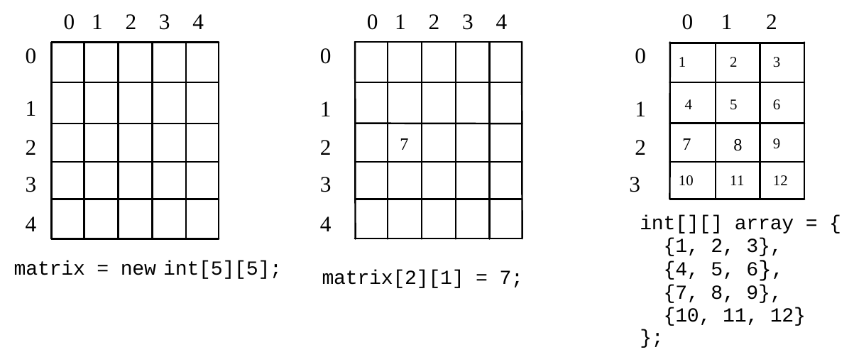
Two-dimensional Array Illustration
matrix.length? 5
matrix[0].length? 5
array.length? 4
array[0].length? 3
OOP · Java basics · 178

Slide 179
Declaring, Creating, and Initializing Using Shorthand Notations
You can also use an array initializer to declare, create and initialize a two-dimensional array. For example,
int[][] array = {
{1, 2, 3},
{4, 5, 6},
{7, 8, 9},
{10, 11, 12}
};
int[][] array = new int[4][3];
array[0][0] = 1; array[0][1] = 2; array[0][2] = 3;
array[1][0] = 4; array[1][1] = 5; array[1][2] = 6;
array[2][0] = 7; array[2][1] = 8; array[2][2] = 9;
array[3][0] = 10; array[3][1] = 11; array[3][2] = 12;
Same as
OOP · Java basics · 179

Slide 180
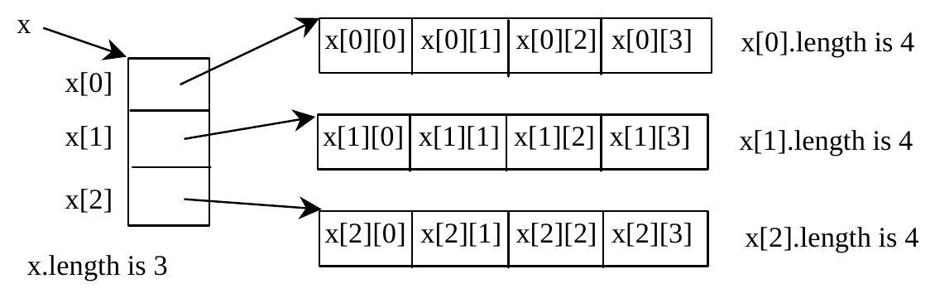
Lengths of Two-dimensional Arrays
int[][] x = new int[3][4];
OOP · Java basics · 180

Slide 181
Lengths of Two-dimensional Arrays, cont.
int[][] array = {
{1, 2, 3},
{4, 5, 6},
{7, 8, 9},
{10, 11, 12}
};
array.length
array[0].length
array[1].length
array[2].length
array[3].length
array[4].length
ArrayIndexOutOfBoundsException
OOP · Java basics · 181

Slide 182
Ragged Arrays
Each row in a two-dimensional array is itself an array. So, the rows can have different lengths. Such an array is known as a ragged array. For example,
int[][] matrix = {
{1, 2, 3, 4, 5},
{2, 3, 4, 5},
{3, 4, 5},
{4, 5},
{5}
};
matrix.length is 5
matrix[0].length is 5
matrix[1].length is 4
matrix[2].length is 3
matrix[3].length is 2
matrix[4].length is 1
OOP · Java basics · 182

Slide 183
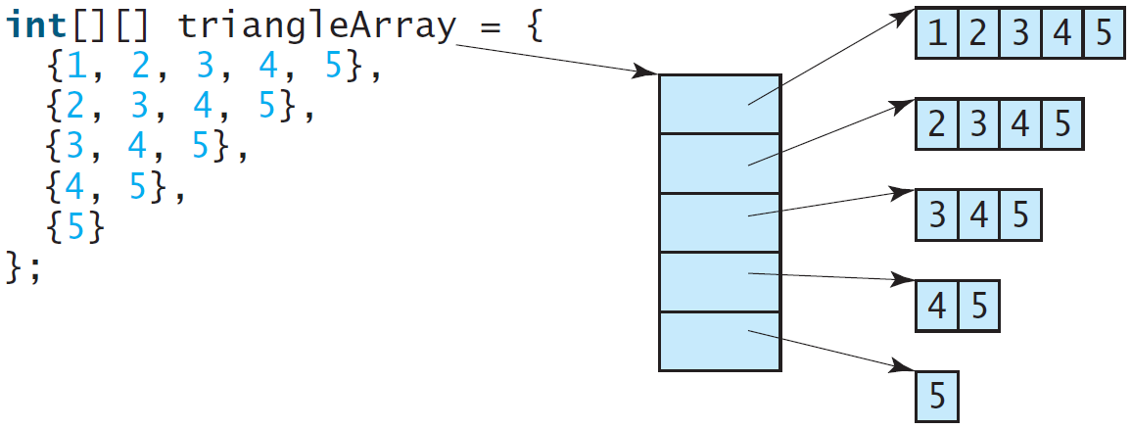
Ragged Arrays, cont.
OOP · Java basics · 183

Slide 184
Multidimensional Arrays
Occasionally, you will need to represent n-dimensional data structures. In Java, you can create n-dimensional arrays for any integer n.
The way to declare two-dimensional array variables and create two-dimensional arrays can be generalized to declare n-dimensional array variables and create n-dimensional arrays for n >= 3. For example, the following syntax declares a three-dimensional array variable scores, creates an array, and assigns its reference to scores.
double[][][] scores = new double[10][5][2];
OOP · Java basics · 184

Slide 185
Recursion
Java basics
OOP · Java basics · 185

Slide 186
Computing Factorial
factorial(0) = 1;
factorial(n) = n*factorial(n-1);
n! = n * (n-1)!
▶ ComputeFactorial
OOP · Java basics · 186

Slide 187
Trace Recursive factorial
Executes factorial(4)
factorial(4)
Stack
Main method
OOP · Java basics · 187

Slide 188
Trace Recursive factorial
Executes factorial(3)
factorial(4)
Step 0: executes factorial(4)
Stack
return 4 *
factorial(3)
Space Required
for factorial(4)
Main method
OOP · Java basics · 188

Slide 189
Trace Recursive factorial
Executes factorial(2)
factorial(4)
Step 0: executes factorial(4)
Stack
return 4 *
factorial(3)
Step 1: executes factorial(3)
return 3 *
factorial(2)
Space Required
for factorial(3)
Space Required
for factorial(4)
Main method
OOP · Java basics · 189

Slide 190
Trace Recursive factorial
Executes factorial(1)
factorial(4)
Step 0: executes factorial(4)
Stack
return 4 *
factorial(3)
Step 1: executes factorial(3)
return 3 *
factorial(2)
Step 2: executes factorial(2)
return 2 *
factorial(1)
Space Required
for factorial(2)
Space Required
for factorial(3)
Space Required
for factorial(4)
Main method
OOP · Java basics · 190

Slide 191
Trace Recursive factorial
Executes factorial(0)
factorial(4)
Step 0: executes factorial(4)
Stack
return 4 *
factorial(3)
Step 1: executes factorial(3)
return 3 *
factorial(2)
Step 2: executes factorial(2)
return 2 *
factorial(1)
Space Required
for factorial(1)
Step 3: executes factorial(1)
Space Required
for factorial(2)
return 1 *
factorial(0)
Space Required
for factorial(3)
Space Required
for factorial(4)
Main method
OOP · Java basics · 191

Slide 192
Trace Recursive factorial
returns 1
factorial(4)
Step 0: executes factorial(4)
Stack
return 4 *
factorial(3)
Step 1: executes factorial(3)
return 3 *
factorial(2)
Step 2: executes factorial(2)
Space Required
for factorial(0)
return 2 *
factorial(1)
Space Required
for factorial(1)
Step 3: executes factorial(1)
Space Required
for factorial(2)
return 1 *
factorial(0)
Step 4: executes factorial(0)
Space Required
for factorial(3)
return 1
Space Required
for factorial(4)
Main method
OOP · Java basics · 192

Slide 193
Trace Recursive factorial
returns factorial(0)
factorial(4)
Step 0: executes factorial(4)
Stack
return 4 *
factorial(3)
Step 1: executes factorial(3)
return 3 *
factorial(2)
Step 2: executes factorial(2)
return 2 *
factorial(1)
Space Required
for factorial(1)
Step 3: executes factorial(1)
Space Required
for factorial(2)
return 1 *
factorial(0)
Step 5: return 1
Step 4: executes factorial(0)
Space Required
for factorial(3)
return 1
Space Required
for factorial(4)
Main method
OOP · Java basics · 193

Slide 194
Trace Recursive factorial
returns factorial(1)
factorial(4)
Step 0: executes factorial(4)
Stack
return 4 *
factorial(3)
Step 1: executes factorial(3)
return 3 *
factorial(2)
Step 2: executes factorial(2)
return 2 *
factorial(1)
Step 6: return 1
Step 3: executes factorial(1)
Space Required
for factorial(2)
return 1 *
factorial(0)
Step 5: return 1
Step 4: executes factorial(0)
Space Required
for factorial(3)
return 1
Space Required
for factorial(4)
Main method
OOP · Java basics · 194

Slide 195
Trace Recursive factorial
returns factorial(2)
factorial(4)
Step 0: executes factorial(4)
Stack
return 4 *
factorial(3)
Step 1: executes factorial(3)
return 3 *
factorial(2)
Step 7: return 2
Step 2: executes factorial(2)
return 2 *
factorial(1)
Step 6: return 1
Step 3: executes factorial(1)
return 1 *
factorial(0)
Step 5: return 1
Step 4: executes factorial(0)
Space Required
for factorial(3)
return 1
Space Required
for factorial(4)
Main method
OOP · Java basics · 195

Slide 196
Trace Recursive factorial
returns factorial(3)
factorial(4)
Step 0: executes factorial(4)
Stack
return 4 *
factorial(3)
Step 8: return 6
Step 1: executes factorial(3)
return 3 *
factorial(2)
Step 7: return 2
Step 2: executes factorial(2)
return 2 *
factorial(1)
Step 6: return 1
Step 3: executes factorial(1)
return 1 *
factorial(0)
Step 5: return 1
Step 4: executes factorial(0)
return 1
Space Required
for factorial(4)
Main method
OOP · Java basics · 196

Slide 197
Trace Recursive factorial
returns factorial(4)
factorial(4)
Step 9: return 24
Step 0: executes factorial(4)
Stack
return 4 *
factorial(3)
Step 8: return 6
Step 1: executes factorial(3)
return 3 *
factorial(2)
Step 7: return 2
Step 2: executes factorial(2)
return 2 *
factorial(1)
Step 6: return 1
Step 3: executes factorial(1)
return 1 *
factorial(0)
Step 5: return 1
Step 4: executes factorial(0)
return 1
Main method
OOP · Java basics · 197

Slide 198
Fibonacci Numbers
Fibonacci series: 0 1 1 2 3 5 8 13 21 34 55 89...
indices: 0 1 2 3 4 5 6 7 8 9 10 11
fib(0) = 0;
fib(1) = 1;
fib(index) = fib(index -1) + fib(index -2); index >=2
fib(3) = fib(2) + fib(1) = (fib(1) + fib(0)) + fib(1) =
(1 + 0) + fib(1) = 1 + fib(1) = 1 + 1 = 2
▶ ComputeFibonacci
OOP · Java basics · 198

Slide 199
Characteristics of Recursion
All recursive methods have the following characteristics:
▫ One or more base cases (the simplest case) are used to stop recursion.
▫ Every recursive call reduces the original problem, bringing it increasingly closer to a base case until it becomes that case.
In general, to solve a problem using recursion, you break it into subproblems.
If a subproblem resembles the original problem, you can apply the same approach to solve the subproblem recursively. This subproblem is almost the same as the original problem in nature with a smaller size.
OOP · Java basics · 199

Slide 200
Arguments
Java basics
OOP · Java basics · 200

Slide 201
Using Command-Line Arguments
▫ Command-line arguments
– Pass arguments from the command line
String args[]
– Appear after the class name in the java command
java MyClass a b
– Number of arguments passed in from command line
args.length
– First command-line argument
args[ 0 ]
OOP · Java basics · 201

Slide 202
Using Command-Line Arguments
C:\javaex\> java sum 5 6 8 -7 13
public class test {
publis static void main(String[] args){
sum=0;
System.out.print("The sum of ");
for(int i:args) {
sum+=i;
System.out.print(i+",");
}
System.out.print(" is "+sum+"\n");
}
}
Output
The sum of 5, 6, 8, -7, 13 is 25
OOP · Java basics · 202

Slide 203
Variable-Length Argument Lists
▫ Variable-length argument lists
– Unspecified number of arguments
– Use ellipsis (…) in method’s parameter list
– Can occur only once in parameter list
– Must be placed at the end of parameter list
– Array whose elements are all of the same type
OOP · Java basics · 203

Slide 204
Variable-Length Argument Lists
public class VarargsTest {
public static double average( double... numbers ) {
double total = 0.0;
for ( double d : numbers )
total += d;
return total / numbers.length;
}
public static void main( String[] args ) {
double d1 = 10.0;
double d2 = 20.0;
double d3 = 30.0;
double d4 = 40.0;
System.out.printf( "d1 = %.1f\nd2 = %.1f\nd3 = %.1f\nd4 = %.1f\n\n", d1, d2, d3, d4 );
System.out.printf( "Average of d1 and d2 is %.1f\n", average( d1, d2 ) );
System.out.printf( "Average of d1, d2 and d3 is %.1f\n", average( d1, d2, d3 ) );
System.out.printf( "Average of d1, d2, d3 and d4 is %.1f\n", average( d1, d2, d3, d4 ) );
}
}
OOP · Java basics · 204

